Slide 1
DIMENSION MEASUREMENT
&CALCULATION
&INSTALLATION

Slide 2
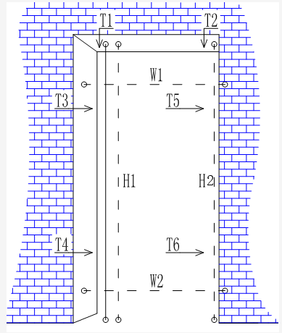
1.MEASUREMENT OF THE DOOR OPENING
Item | Measuring point | Values
Height | H1、H2 | Min Value
Width | W1、W2 | Min Value
Wall thickness | Top: T1、T2 | Max Value
 | Side: T3、T4、 T5、T6
Note: The height of the blank wall should be measured from the horizontal line elevation. The wall thickness is based on the finished surface. The thickness of the tile should be considered.

Slide 3
2. SIZE CALCULATION 1 SINGLE DOOR
Measured Data：2100*900*230mm
Door Frame Size：
2100-20/bottom plank interval*900-40/bottom plank interval*230
=2080*860*230
Door Leaf Size：
(2080-25/main plank -10/door seam)*(860-50/main plank-6/door seam)*40
=2040*804*40

Slide 4
2. SIZE CALCULATION 2 DOUBLE DOOR
Measured Data：2100*1700*230
Door Frame Size：
2100-20/bottom plank interval*1700-40/bottom plank interval*230
=2080*1660*230
Door Leaf Size：
(2080-25/main plank-10/door seam)*(1660-50/main plank-8/door seam)*45
=2045*1602*45

Slide 5
2.DIMENSIONING 3 SLIDING DOOR SECTION

Slide 6
2.DIMENSIONING 4 DOUBLE SLIDING DOOR
Measured Data：2100*1700*230
Door Frame Size：
2100-20/bottom plank interval*1700-40/bottom plank interval*230
=2080*1660*230
Door Leaf Size：
(2080-28/main plank thickness-50/pulley gap)*(1660-56/main plank thickness+100/overlap width)/2*40
=2002*（852+852）*40

Slide 7
2.DIMENSIONING 5 FOUR SLIDING DOOR
Measured Data：2100*2800*230
Door Frame Size：
2100-20/bottom plank interval*2800-40/bottom plank interval*230
=2080*2760*230
Door Leaf Size：
(2080-28/main plank thickness-50/pulley gap)*(2760-56/main plank thickness+200/overlap width)/4*40
=2002*(726*4)*40

Slide 8
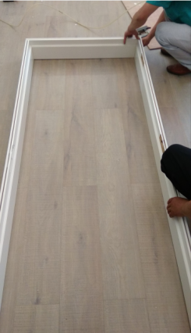
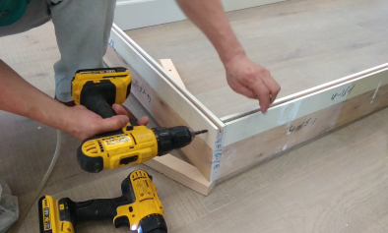
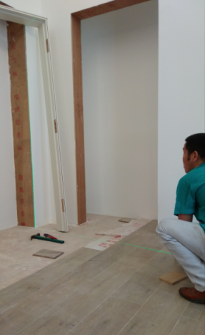
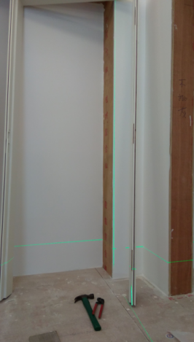
3.INSTALLATION：Before installing the door, please reserve the door opening: finish the wall facing, plaster the side walls and keep the wall on three sides vertical/horizontal.
Step One:
Confirm the swing direction. Fix the jamb head to the top of the stiles with screws on the floor.
Step Two:
Check the verticality of the door opening with gradienter. Determine the thickness of the baseboard according to the positive or negative difference between the opening size and the frame size. Drill the wall, fill the hole with wood strips and nail the baseboard to the wood strips.

Slide 9
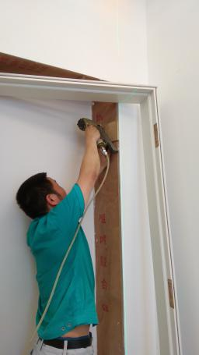
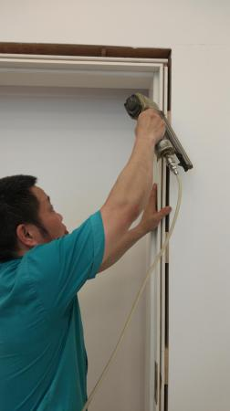
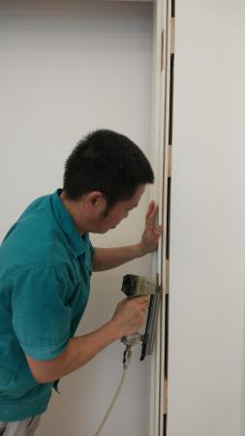
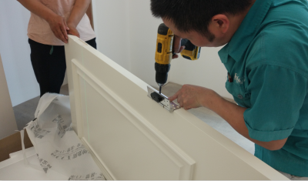
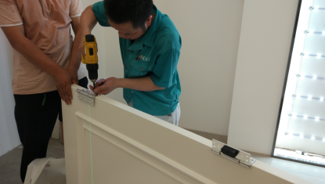
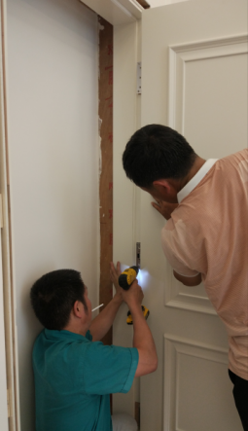
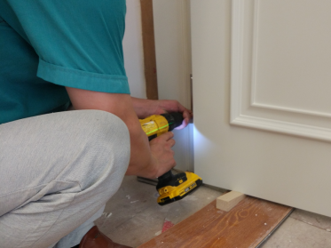
Step Three:
Stand the assembled jamb set in the door opening. Angle screw on or nail the baseboard along the mainboard slot. Fill the gap between the jamb set and the opening with polyurethane foam sealing agent.
Step Five:
Remove the door to the hinged jamb stile. Adjust the distance between the door and the hinged jamb stile
Step Four: Fix the hinges to the door.

Slide 10
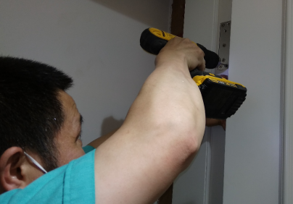
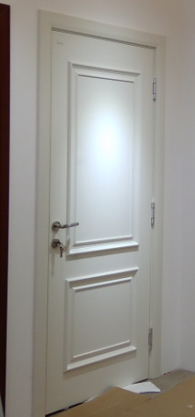
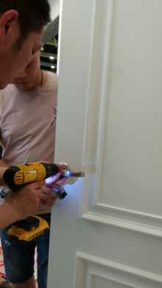
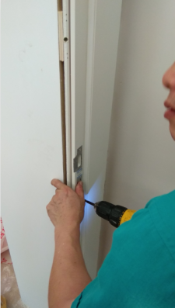
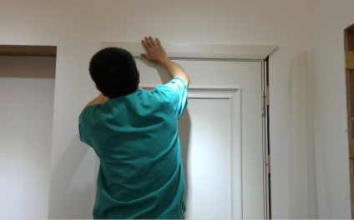
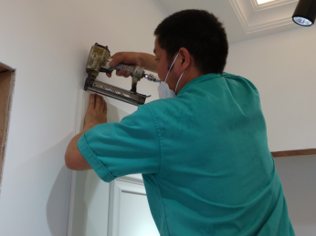
Step Six:
Confirm the door open&close condition and the distance position between jambs & jamb head and floor
Step Seven:
After confirmation, fix the hinges to the stile fully.
Step Eight:
Install the door lock, ensure that the door can be opened and closed smoothly.
Step Nine:
Fix the architraves

