Slide 1


Better tools Better Life
产品介绍PPT
PRODUCT INTRODUCTION / NEW PRODUCT RELEASE
PRODUCT INTRODUCTION
Shanghai Techway Industrial Co., Ltd.
演讲人：Asen

Slide 2
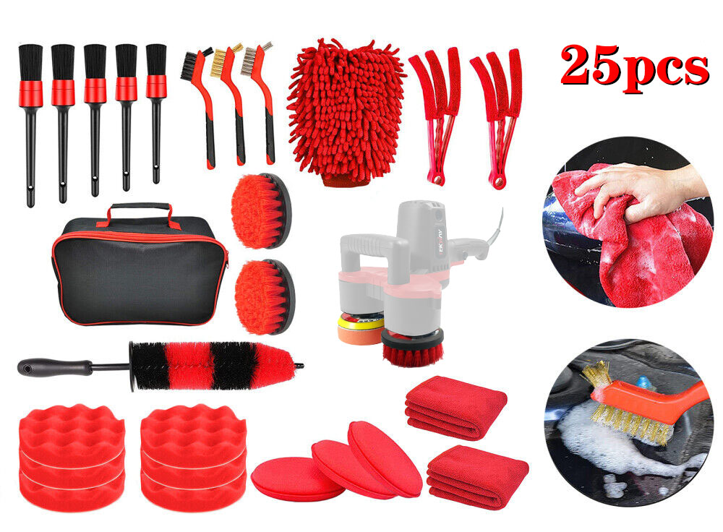
Plan A: 25-piece car cleaning set
3 pieces of wire brushes for rusting removing
5 different sizes of car detailing brushes
2 machine cleaning brushes(attach to double head machine)
6 polishing foam pad
2 microfiber towel
3 manual waxing pad
2 air conditioner brush
1 wheel brush
Our Car Interior Detailing Kit Comes With A Carry Bag To Keep Everything Organized.

Slide 3
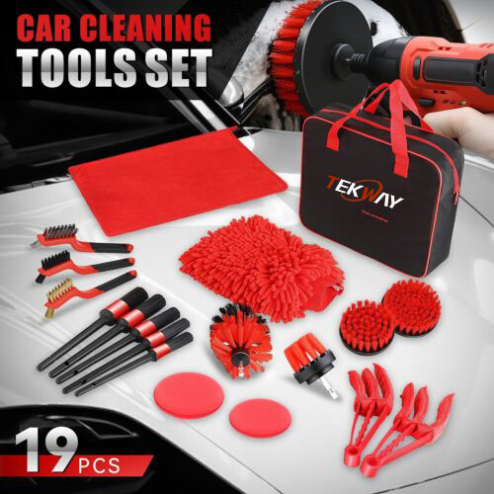
Plan B: 19-piece car cleaning set
5 Different Sizes (8.5", 9.2", 9.3", 9.5", 9.9") of Detail Brushes, Bristles are Soft Enough to Protect the Surface
4.5" & 4" Diameter Round Flat Brush for Larger Flat Surface
3.5" Brush Best for Interior Corners
2" Brush for the Tight Apices or Hard-to-Reach Spaces
3Pcs 7" Wire Burshes - 1 x Stainless Steel Brush, 1 x Brass Brush, 1 x Nylon Brush
The Air Vent Brush Designed for Easy Handling and Brushing Car Air Vents
Microfiber Wash Mitt with Internal Waterproof Design, Elastic Wrist Cuff Keeps Mitt in Place on Hand
Microfiber Wax Applicators, Washable and Reusable
The Cleaning Towel is Soft and Lint, can be Wiped Dry or Wet

Slide 4
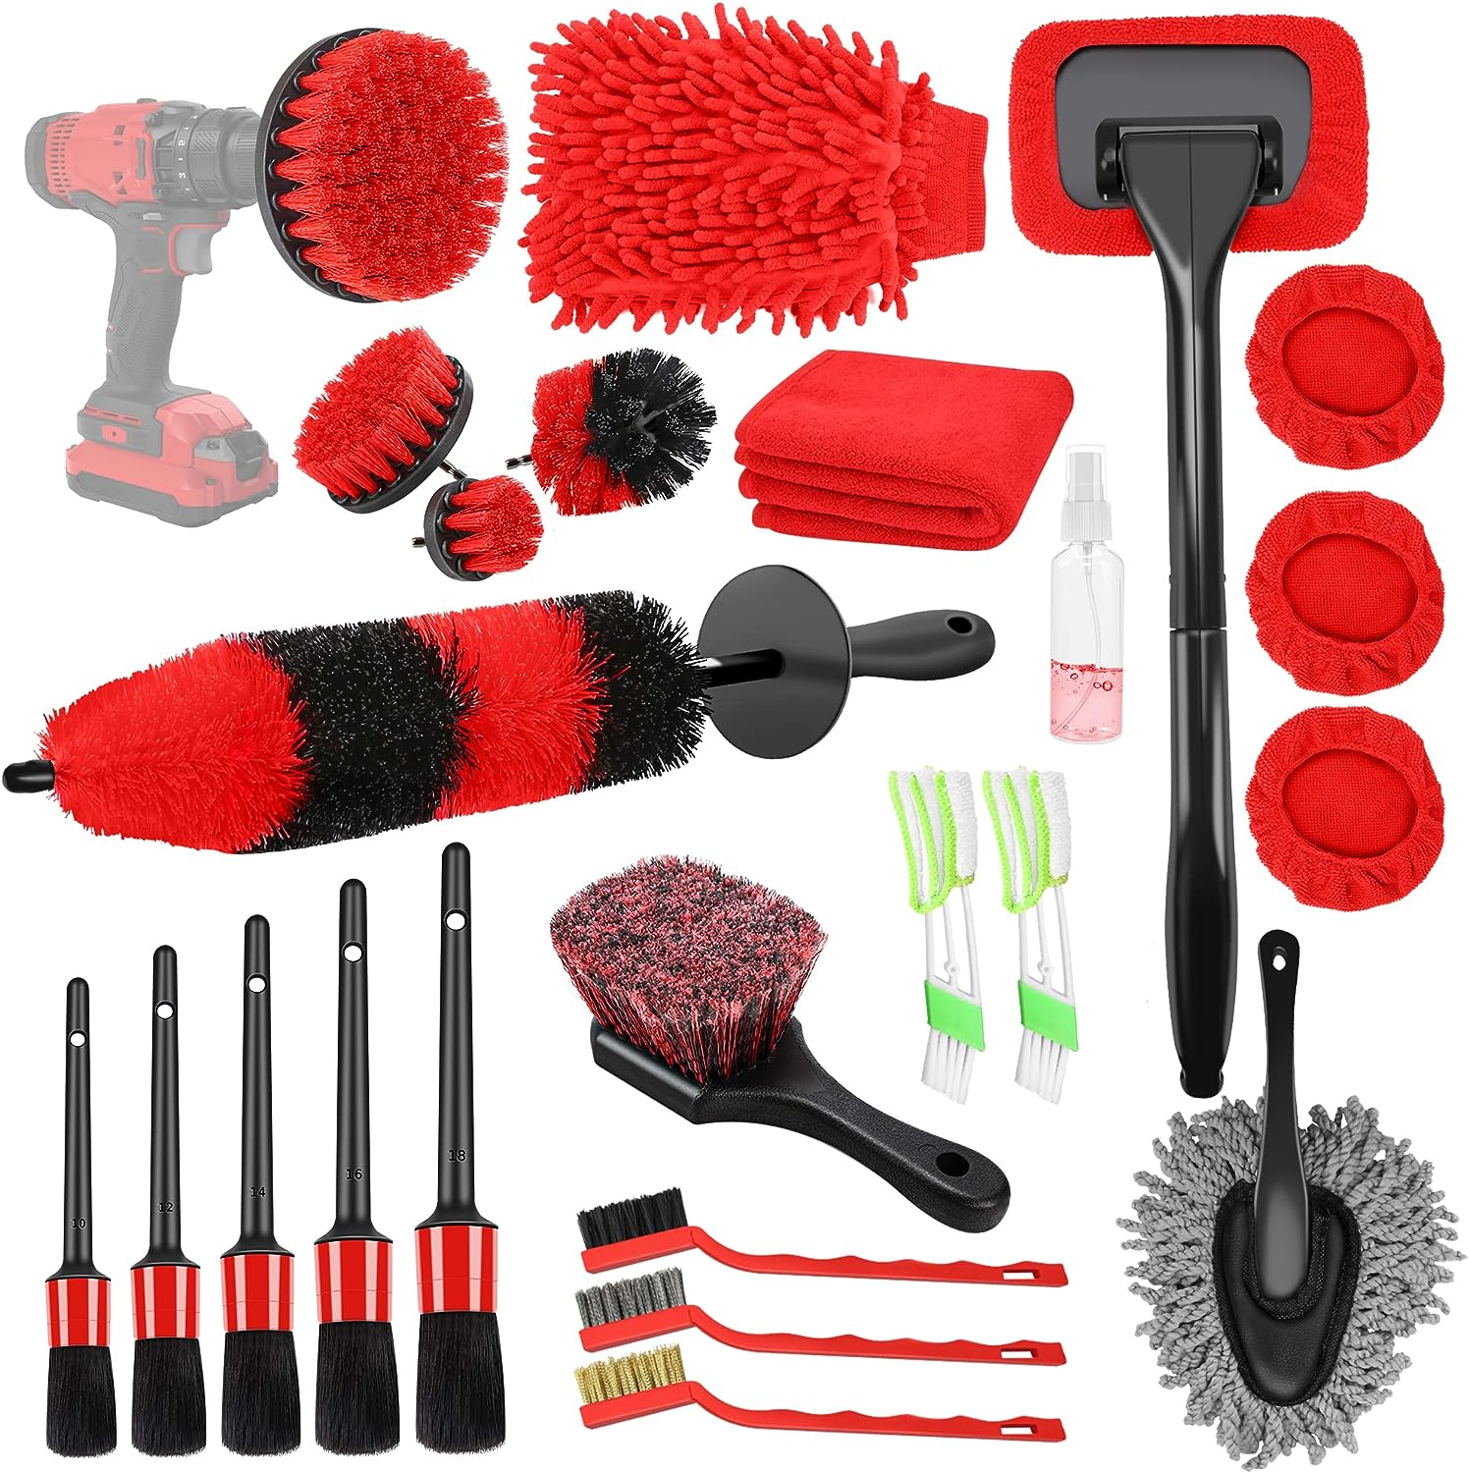
Plan C: 25-piece car cleaning set
1、Efficient 25 Pcs-in-1 Car Wash Kit — The complete and decent detailing kit equipped with 5 detailing brush set, 4 drill brushes, 3 wire brush, 2 vent cleaning brush, wheel brush, tire brush, 1 detachable handle, 4 of strong water absorption cloth cover and a 100ml spray bottle, dash duster brush, car wash towel and car wash mitt.
2、Excellent completion of all works required for external and internal details! A gift for car buffs.

Slide 5
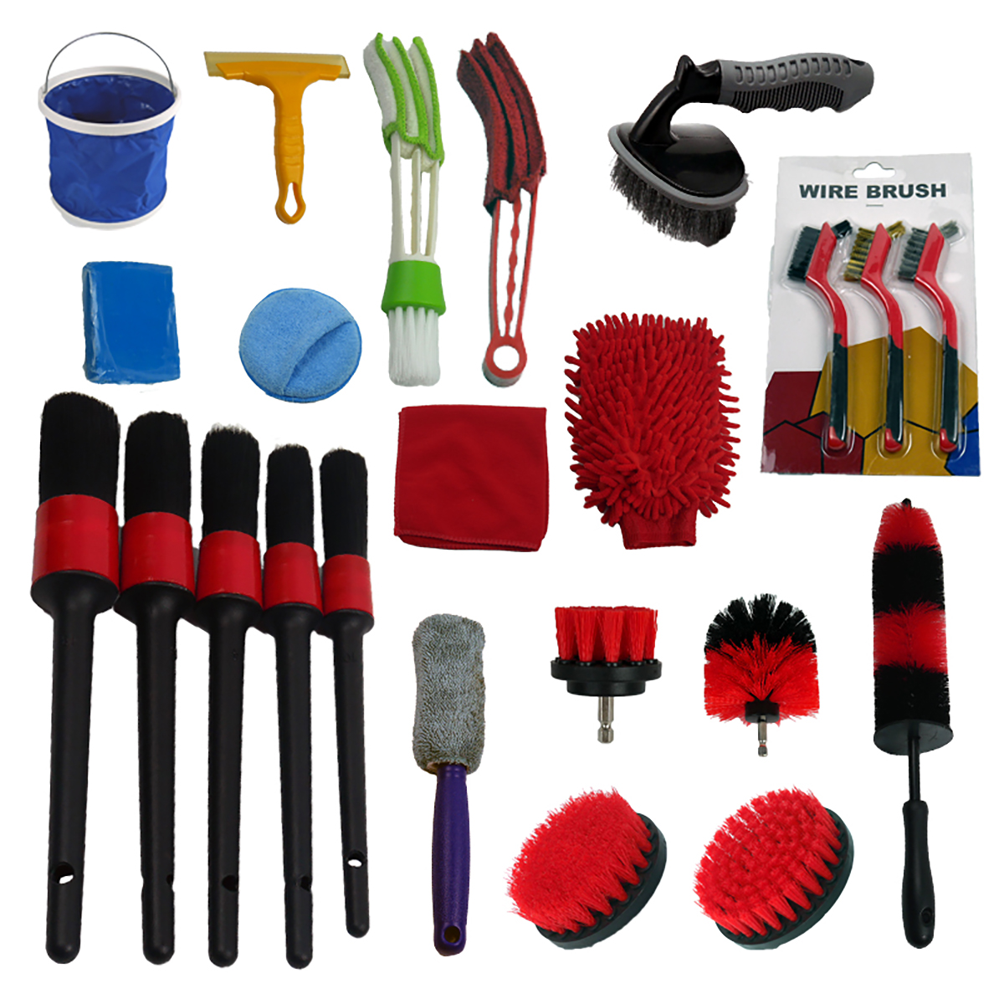
Plan D: 23-piece car cleaning set
1、Efficient 23 Pcs-in-1 Car Wash Kit：
5 detailing brush set,
4 drill brushes,
3 wire brush,
2 vent cleaning brush,
1 wheel brush,
1 tire brush
1 detachable handle
1 strong water absorption cloth cover and dash duster brush, car wash towel and car wash mitt.
2、23PCS of interior car detailing kit make your car shiny and cleaning dirt
3、Owning a professional and quality car cleaning kit interior detailing kit makes your cleaning much easier while take it to the next level.

Slide 6
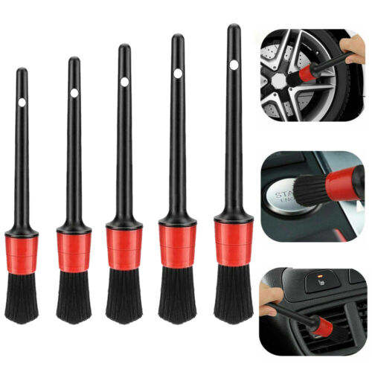
Clean detail brush
Type: 10#/12#/14#/16#/18#
Bristle length:5 cm
Color:Black+Red
Material: PP+ABS
Features:
High-strength plastic handle, good hardness, not easy to break, sturdy and durable.
Black and red contrast color design, stylish personality, beautiful and generous, attracting attention.

Slide 7
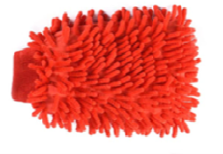
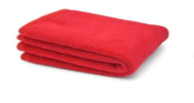
Towel
Capable of holding over a gallon of water and drying an entire car in one pass for efficient, large-scale detailing.Features a premium 70/30 microfiber blend, scratch-free wiping on sensitive paintwork.Picks up any missed dirt without scratching, offering the perfect finish.
Cleaning gloves
The cleaning kit is made of soft and durable microfiber material, comfortable and easy to handle, lint-free, scratch-free and swirl-free, maximizing soapy water absorption and effectively removing dirt.

Slide 8
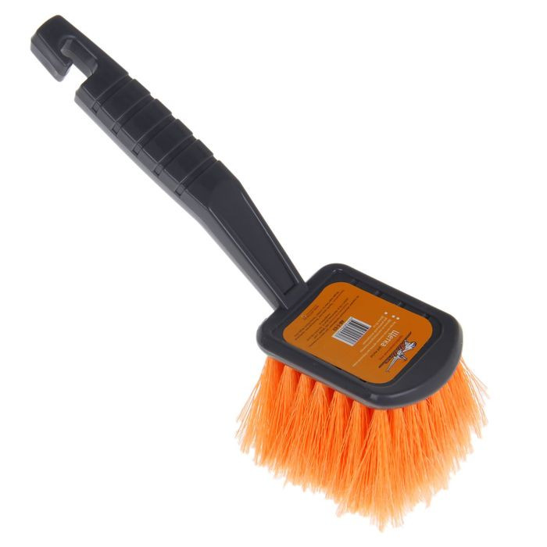
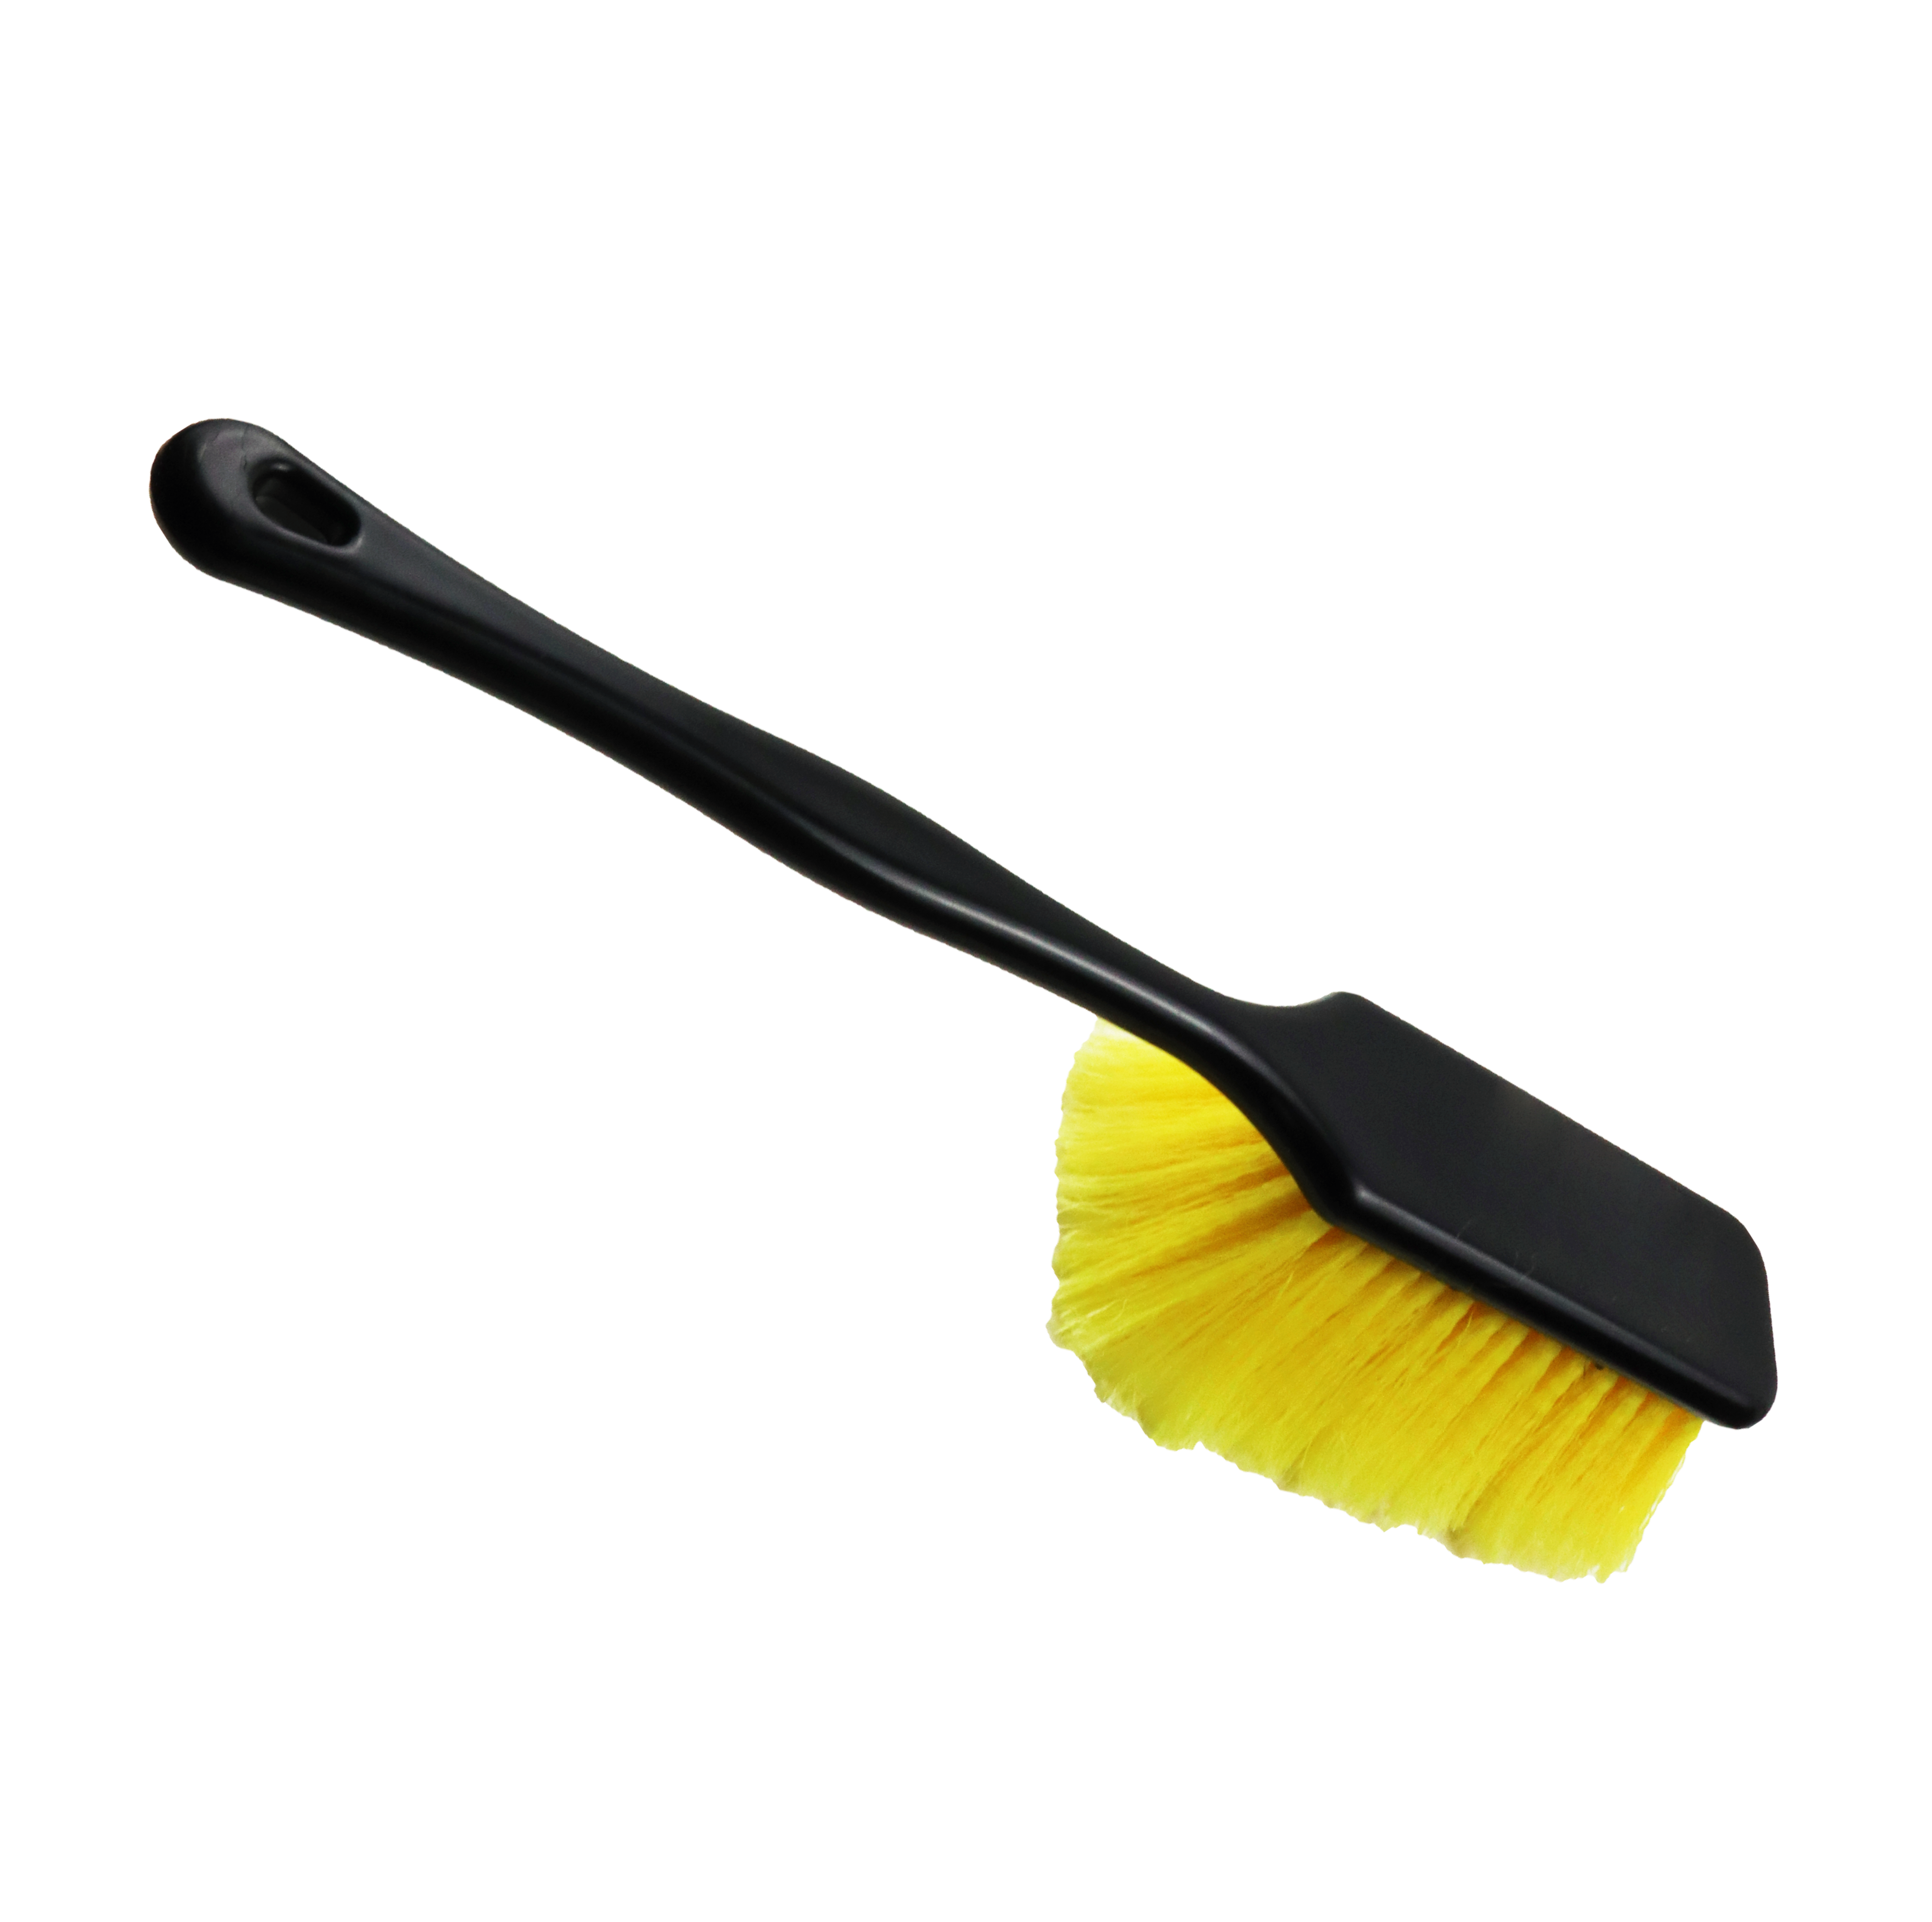
TW-ACPV21
TW-ACPV17
Working part width: 9 cm
Bristle diameter: 0,3mm.
Brush Length: 25 cm
Brush width: 9 cm
The car wash brush is designed specifically for cleaning from car pollution, without damaging the paint surface of the car. The brush for washing the machine is equipped with a handle made of light plastic. The car brush has a working surface made of soft dissolved bristles.
Working part width: 8 cm
Bristle diameter: 0,3mm.
Brush Length: 38 cm
Brush width: 8 cm
The car wash brush is designed specifically for cleaning from car pollution, without damaging the paint surface of the car. The brush for washing the machine is equipped with a handle made of light plastic. The car brush has a working surface made of soft dissolved bristles.

Slide 9
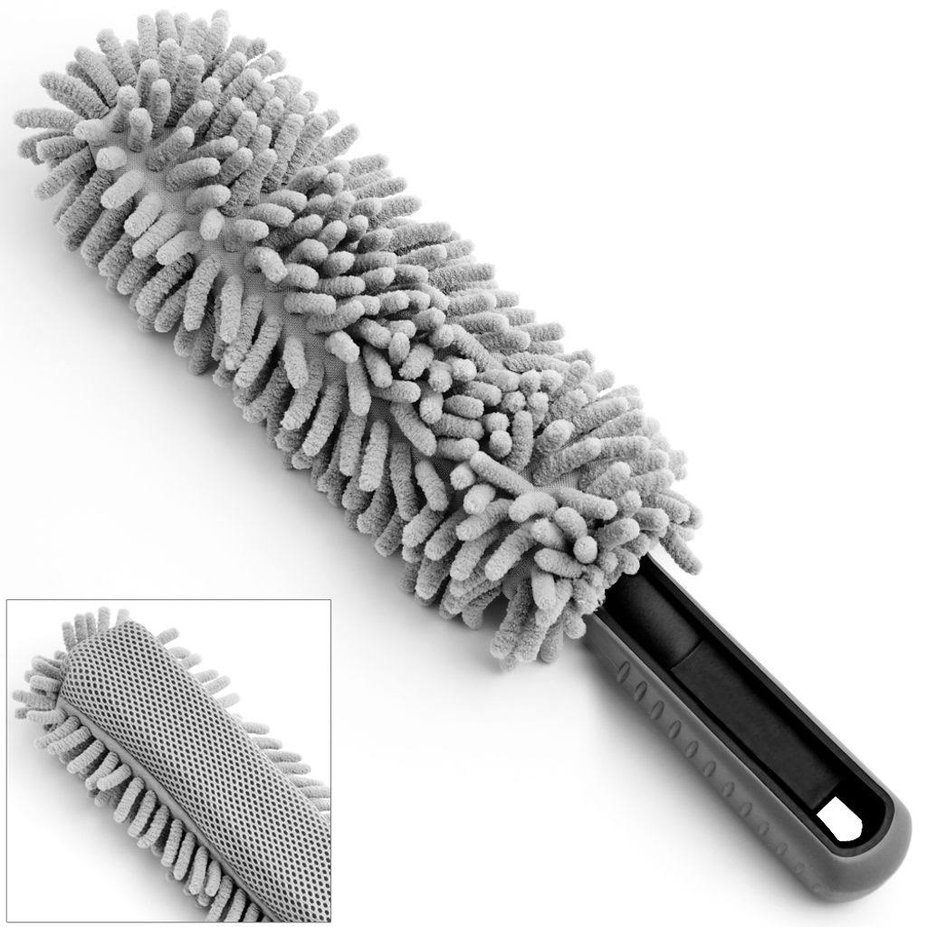
Microfibre Rim Brush
Materiale: ciniglia, polipropilene, gomma.
Dimensioni: 34 cm x 5,5 cm.
Lunghezza dell'impugnatura: 10 cm.
Colore: grigio
The cleaning brush has two different sides. The soft microfibre side with long bristles ensures gentle treatment of your rims. The other side is equipped with a sponge so you can remove stubborn dirt quickly and easily. You can use both sides of the car wash brush on aluminum or steel rims without scratching them
The brush is flexible, so it is possible to reach even hard-to-reach places. The length of the brush of 34 cm allows you to reach even deep into the narrow spaces between the rims

Slide 10
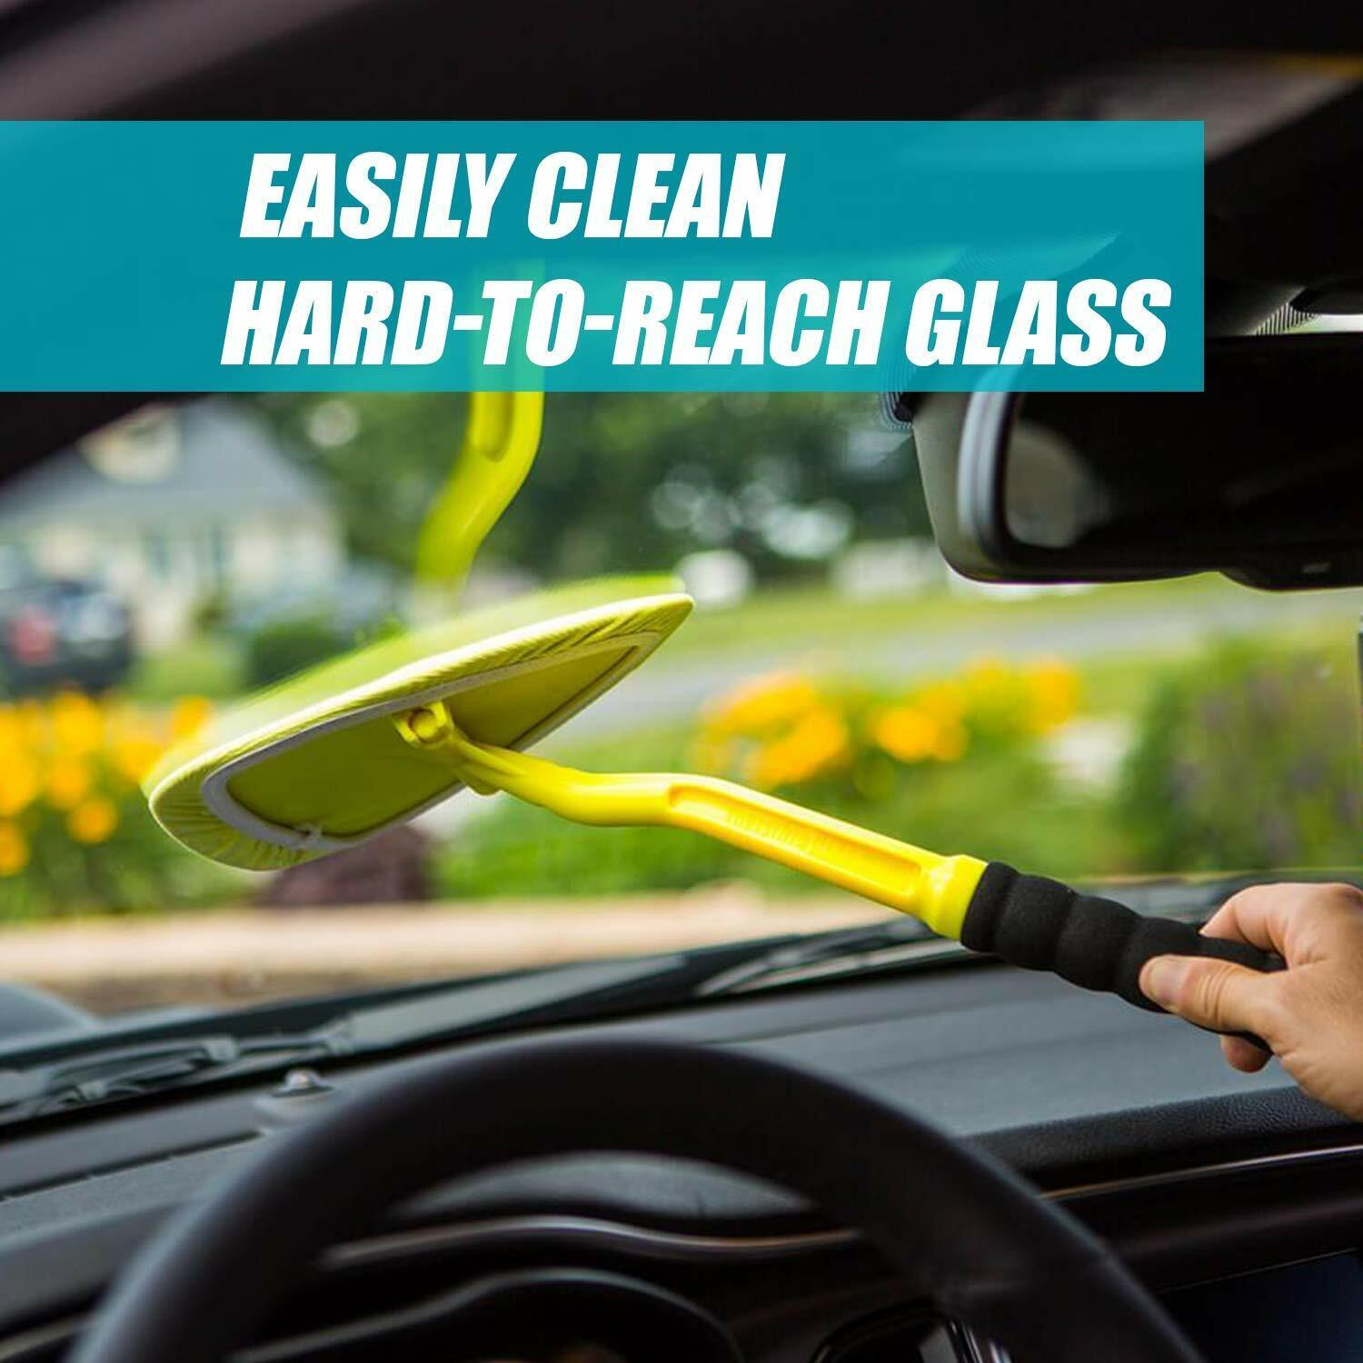
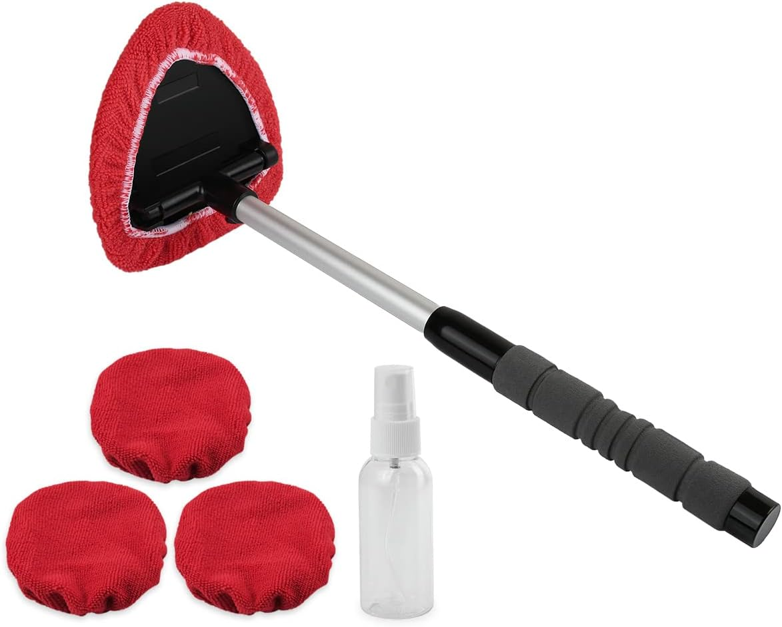
TW-ACPV20
TW-ACP2V12
Product Dimensions
2.25 x 7.25 x 11 inches
It combines an ergonomic, long reach handle and large triangular pivoting heat with two washable, reversible, microfiber covers to make automotive glass cleaning faster and easier than ever. Ideal for all hard-to-reach areas! To make automotive windshield and windows shine. Wash and rinse first, then clean and dry with the detachable Reach & Clean Tool.
Packaging dimensions: 31.19 x 22.81 x 3.61 cm; 168 g
The wiper cleaner tool has a long, sturdy plastic handle and triangular pivoting cleaning head. It is also great for cleaning windows on tall vehicles
Just slip any of the three included cleaning covers on to the head, spray on some cleaning agent and start cleaning - The windshield washing tool has a 180 degree swiveled triangular head to make a complete contact to the glass

Slide 11
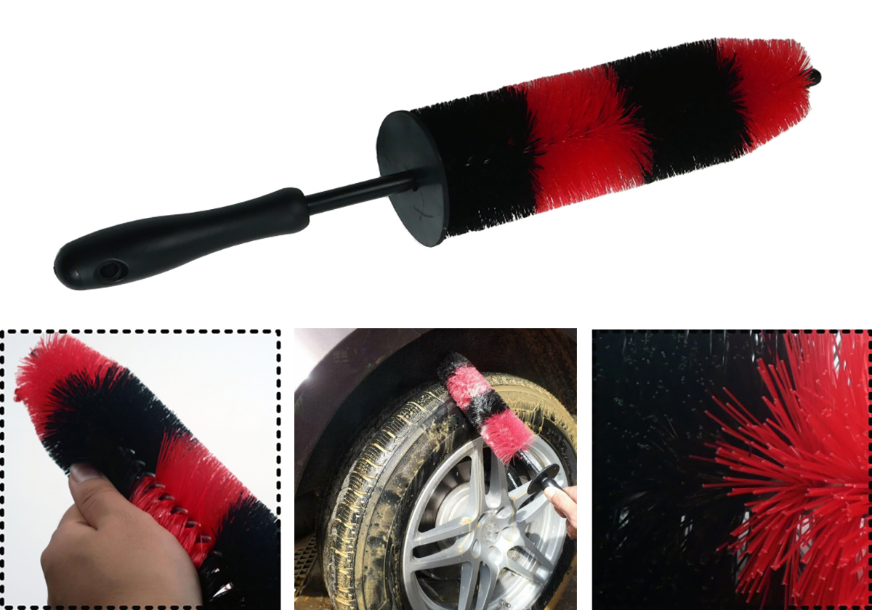
wheel brush
car wheel cleaning brush，Compact and lightweight, it is easy to store and easy to use and carry.
It can be washed, easy to clean, and it is forbidden to use corrosive liquids.

Slide 12
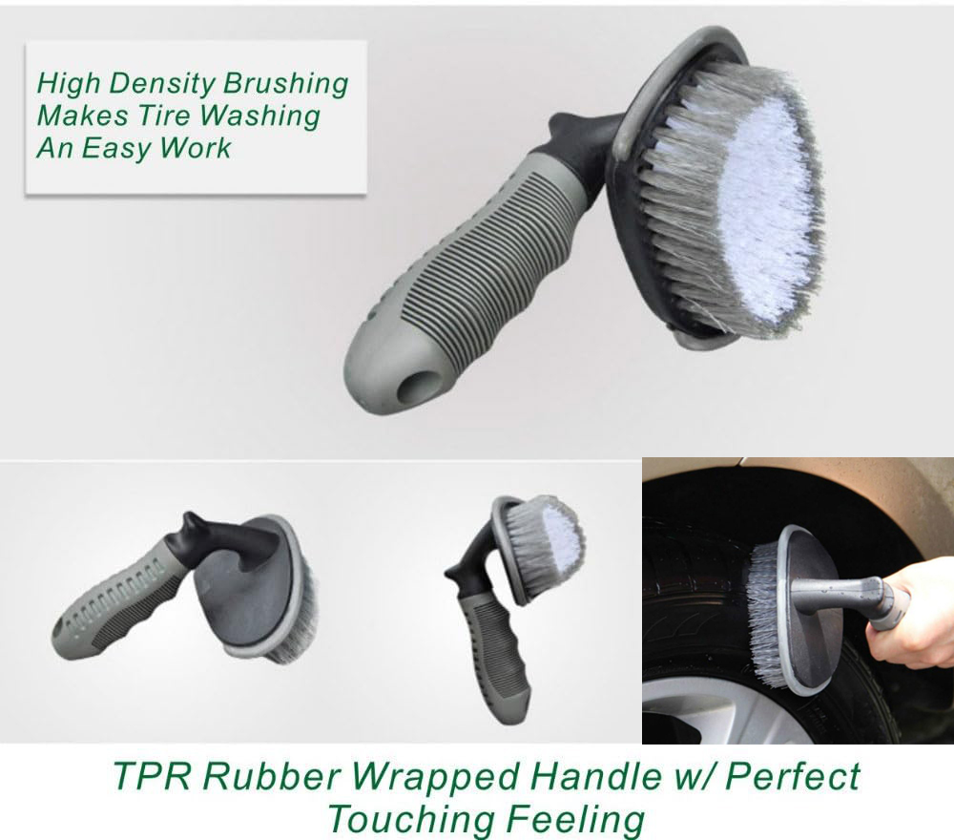
car tire brush
Universal Wheel Rim Brush with TPR Handle For tyres, spokes, steel wheels, scooter, car, truck, bicycle, sink, bathroom, toilet, floor cleaning, ceramic. The handle end has a hole for hanging.
Size: 135mm x 130mm x 65mm
Weight: approx. 200 g.
1. Effective cleaning of tyres, chassis and other dirt. This brush has hard bristles for thorough cleaning of the dirt.
2. Easy to use.
3. Ergonomic handle, smooth shape, comfortable to use. The L-shaped design of the wide rim brush makes washing the tires a breeze.

Slide 13
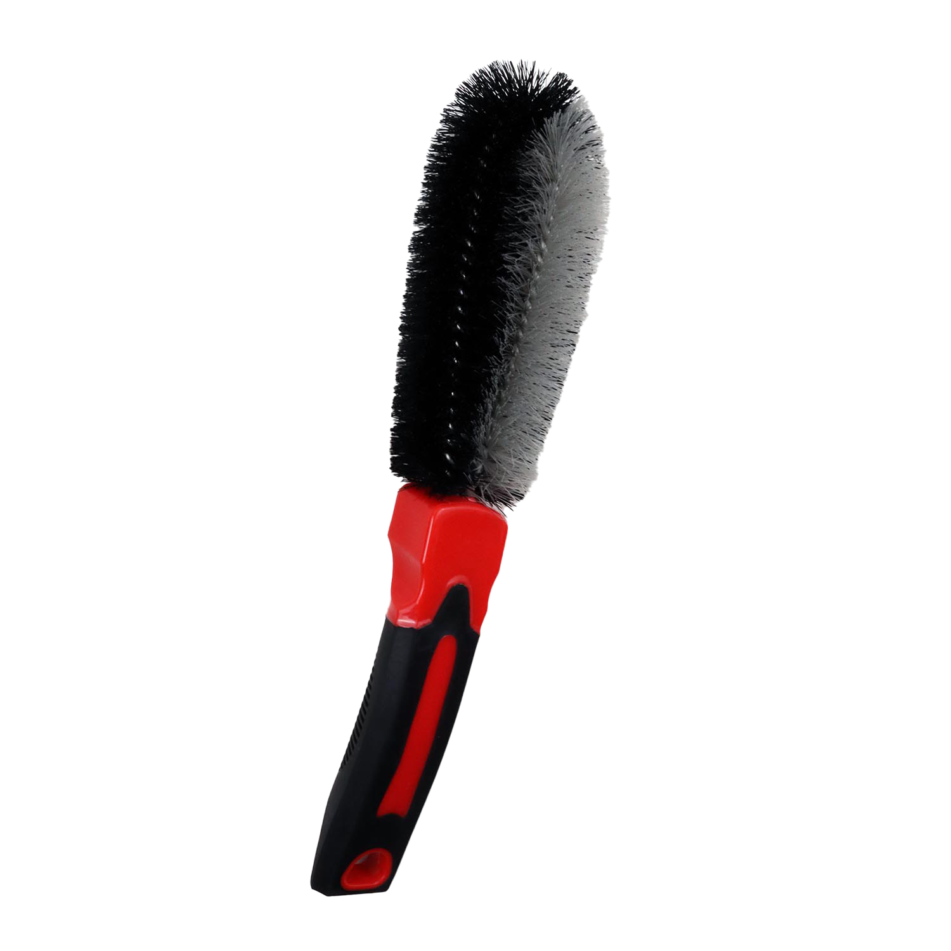
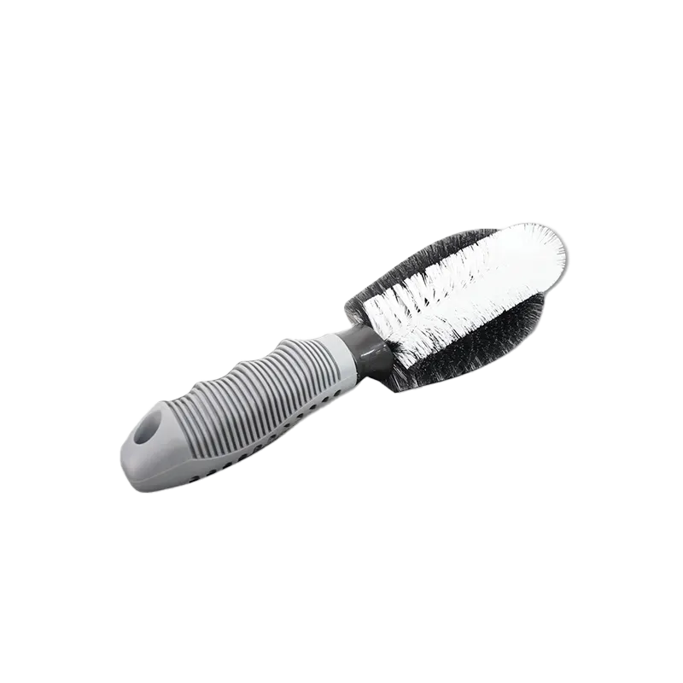
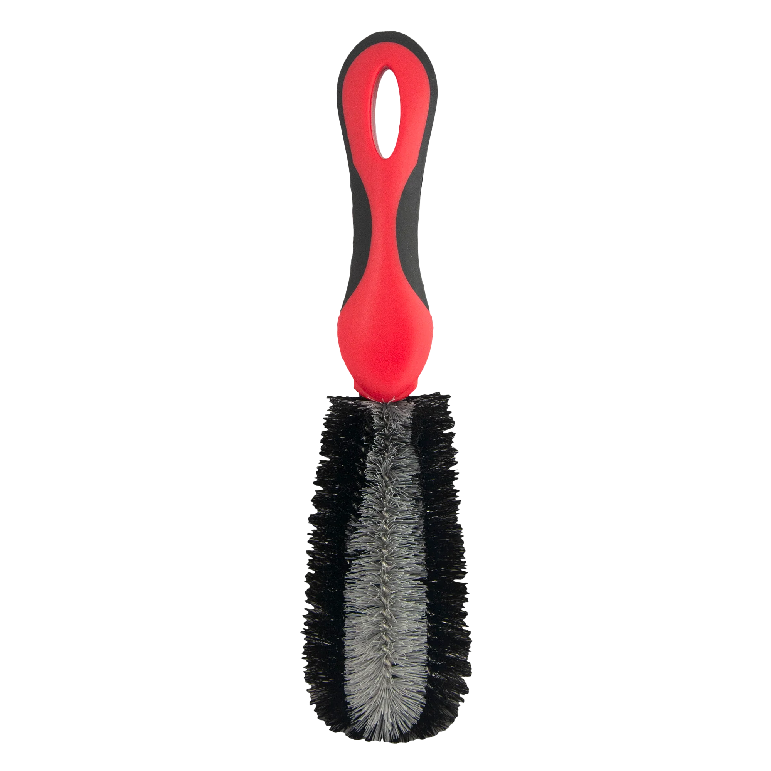
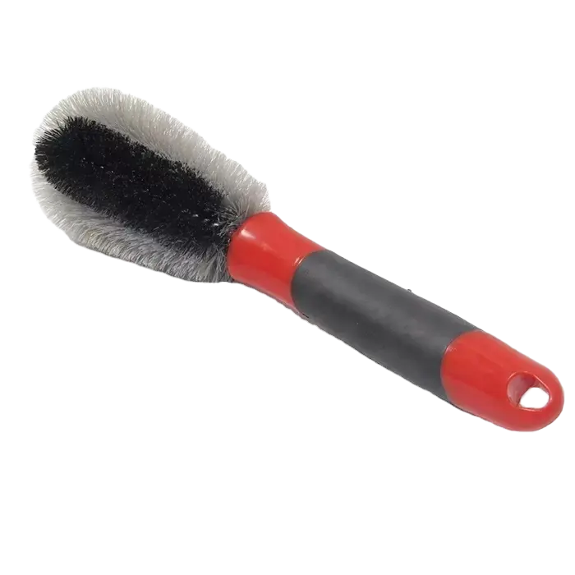
TW-ACPV22
TW-ACPV16
Brand TEKWAY
Dimensions 29.5 × 7.5 × 6.5cm
Handle material PP with TPR
Eliminate dirt, dust, and grime from your wheels and spokes; Scouring brush is effective at removing debris
More bristles for extra cleaning power; clean rim and hub with ease
Over 11 inches long to clean hard to reach areas; Comfortable handle makes it easy to hold and use
Use on cars, motorcycles, bicycles, trucks, and more
Brand TEKWAY
Dimensions 29.5 × 7.5 × 6.5cm
Handle material PP with TPR
Eliminate dirt, dust, and grime from your wheels and spokes; Scouring brush is effective at removing debris
More bristles for extra cleaning power; clean rim and hub with ease
Over 11 inches long to clean hard to reach areas; Comfortable handle makes it easy to hold and use
Use on cars, motorcycles, bicycles, trucks, and more
TW-ACPV23
TW-ACPV24
Brand TEKWAY
Dimensions 11.25 x 2.75 x 2.75 inches
Handle material PP with TPR
Eliminate dirt, dust, and grime from your wheels and spokes; Scouring brush is effective at removing debris
More bristles for extra cleaning power; clean rim and hub with ease
Over 11 inches long to clean hard to reach areas; Comfortable handle makes it easy to hold and use
Use on cars, motorcycles, bicycles, trucks, and more
Brand TEKWAY
Dimensions 29.5 × 7.5 × 6.5cm
Handle material PP with TPR
Eliminate dirt, dust, and grime from your wheels and spokes; Scouring brush is effective at removing debris
More bristles for extra cleaning power; clean rim and hub with ease
Over 11 inches long to clean hard to reach areas; Comfortable handle makes it easy to hold and use
Use on cars, motorcycles, bicycles, trucks, and more

Slide 14
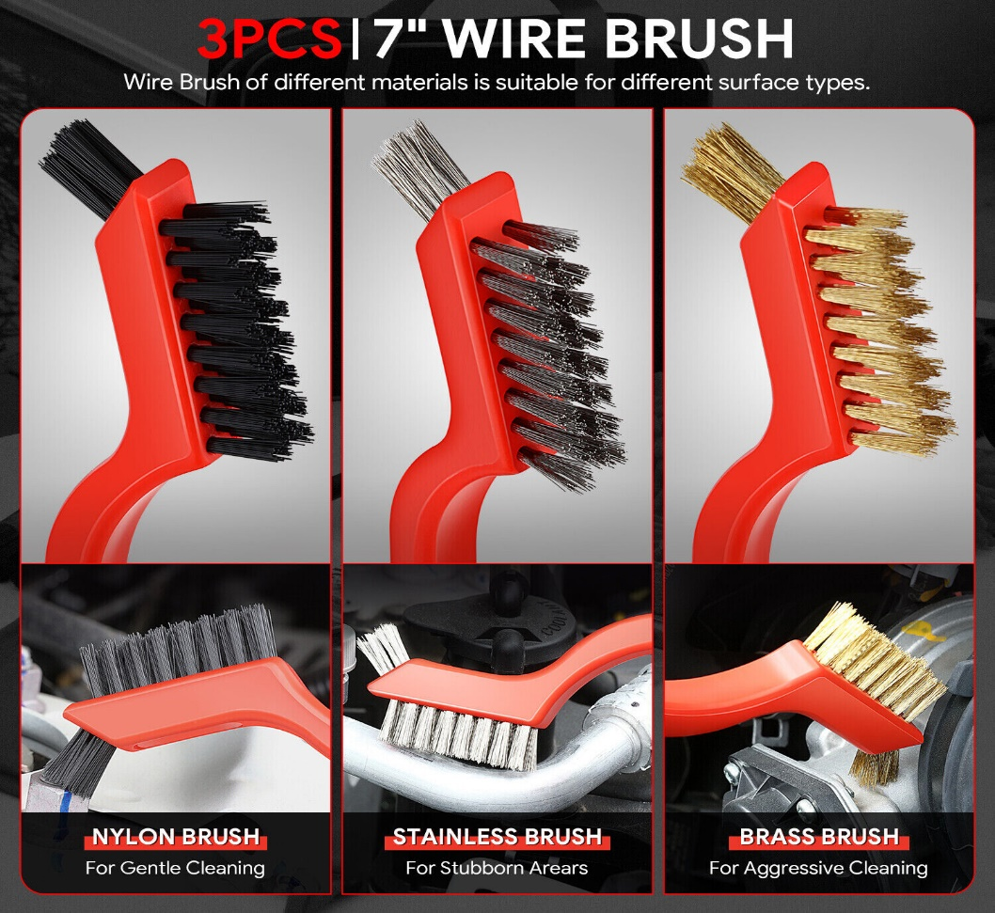
3 piece cleaning brush set
Using high-quality materials, the three-piece mini brush is made of three different materials, namely brass wire, nylon wire and stainless steel wire. They are high quality, last a long time, and effectively clean corners, corners, and all those weird cracks. Each brush is made with different bristles. Hard stainless steel bristles can be used to clean parts, clean heavy duty, spray paint, rust, etc. Soft nylon bristles for cleaning and sensitive parts. Curly brass bristles clean unpolished metal parts without damaging surfaces or finesse.
Small brush head design: The back is designed with a small brush head, which can clean well in a small room and clean many corners or crack edges, which is very practical.
Easy to use: The cleaning brush has a smooth and comfortable soft rubber handle, which is easy to hold and control. The plastic handle is durable and easy to clean. There is also a tail hook design for easy organization and storage.

Slide 15
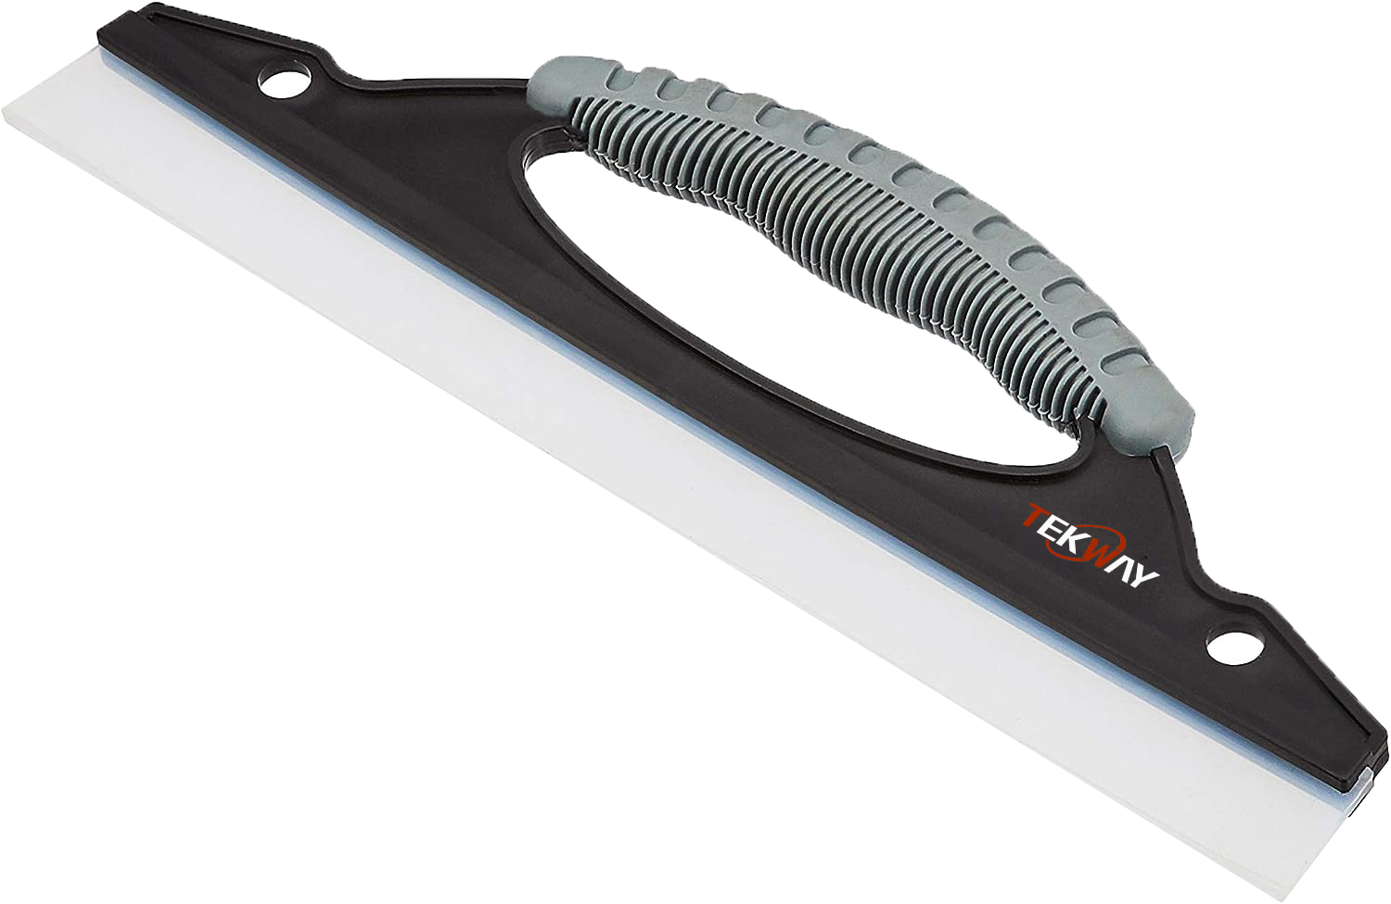
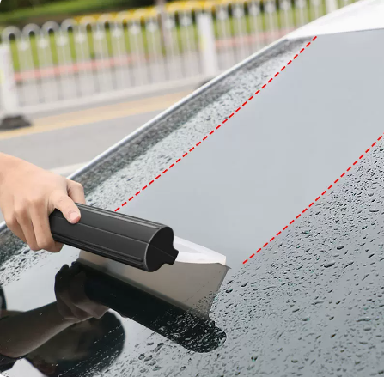
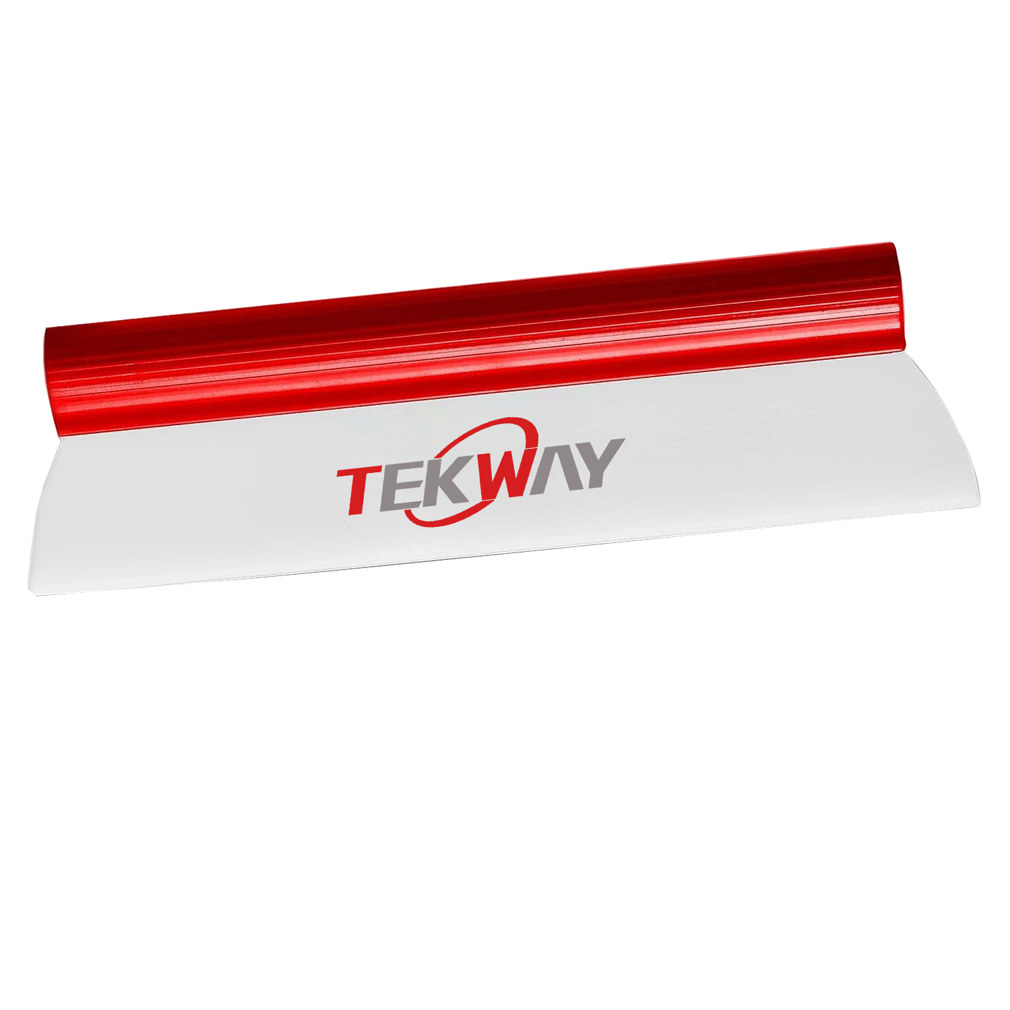
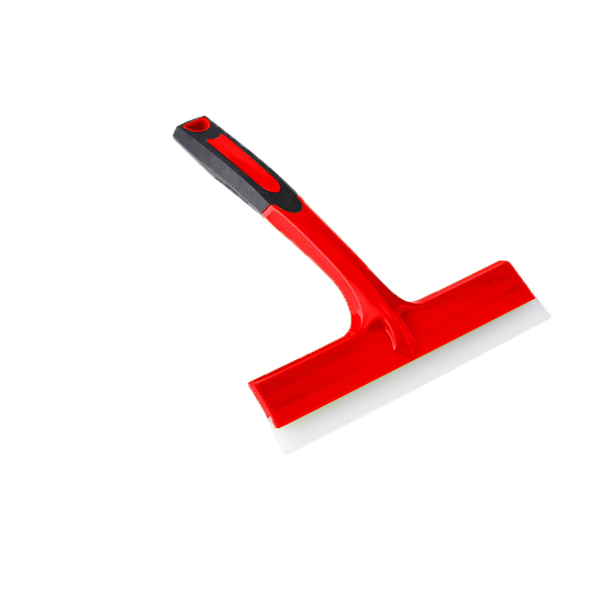
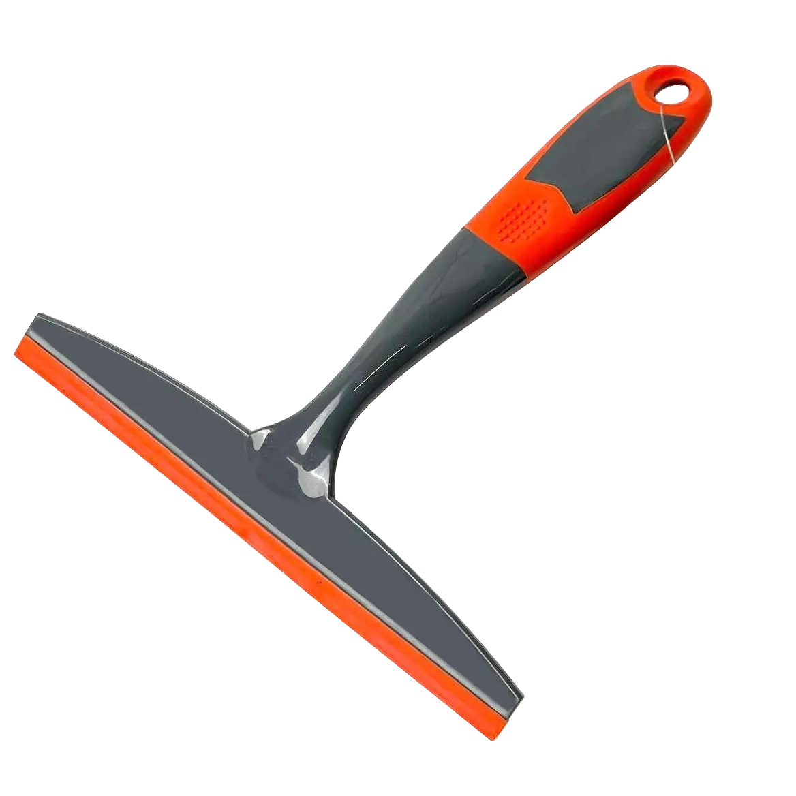
TW-ACP31V18
TW-ACPV13
Colour White, Black, Grey
Style Without handle
Item dimensions L x W x H30 x 9.5 x 1.5 centimetres
Item weight 0.25 Pounds
Multipurpose window squeegee for peeling windows, windscreens, mirrors, tiles, shower surfaces and more
Transports water quickly for squeak-free, streak-free results
Integrated anti-slip handle for comfort and an easy, stable hold
Lightweight, compact design for easy handling and storage Durable rubber lip Hanging hole for convenient storage and drying
Colour Red-white
Material Mikrofaser
Professional equivalent for large-scale drying of the wet vehicle after washing. Adapts perfectly to the vehicle contours with super soft silicone, works smoothly and leaves no scratches.
Safety the water blade squeegee requires much less effort, because the silicone lip is attached directly to the handle. Water and other liquids are easily removed from the body and the windows – in just one move!
TW-ACPV14
TW-ACPV15
Brand TEKWAY
Blade material Gummilippe
Handle material Kunststoff
Width 21 cm, length: 28 cm
Ideal for windows, aquariums, car windows, glass doors and other flat surfaces.
Wide rubber lip for streak-free removal
Ergonomic handle
Professional equivalent for large-scale drying of the wet vehicle after washing. Adapts perfectly to the vehicle contours with super soft silicone, works smoothly and leaves no scratches.
Brand TEKWAY
Blade material Gummilippe
Handle material Kunststoff
Width 21 cm, length: 25 cm
Ideal for windows, aquariums, car windows, glass doors and other flat surfaces.
Wide rubber lip for streak-free removal
Ergonomic handle
Professional equivalent for large-scale drying of the wet vehicle after washing. Adapts perfectly to the vehicle contours with super soft silicone, works smoothly and leaves no scratches.

Slide 16
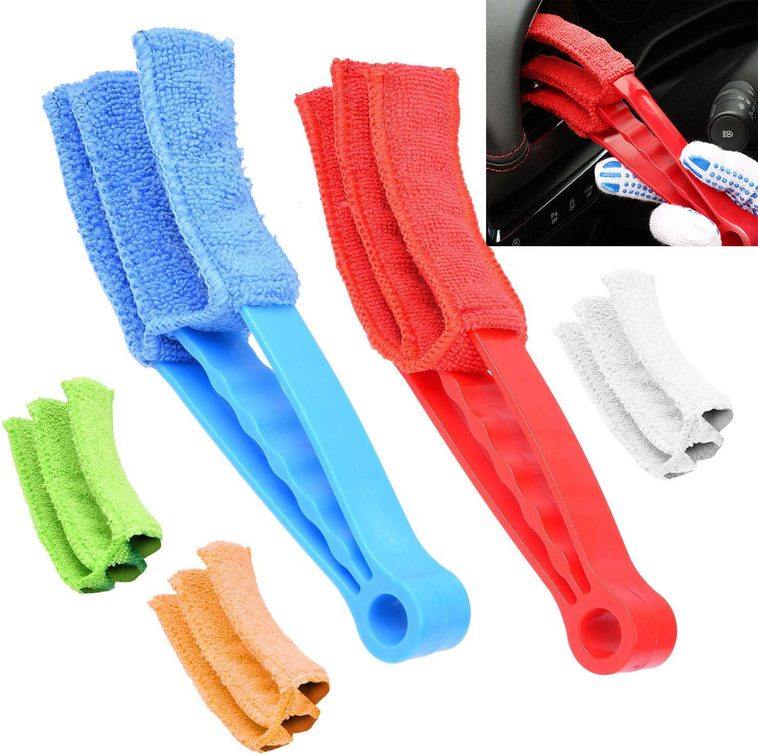
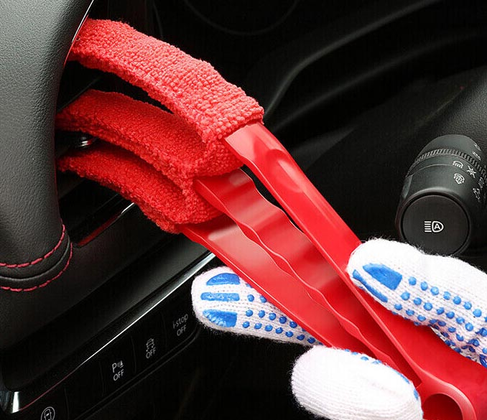
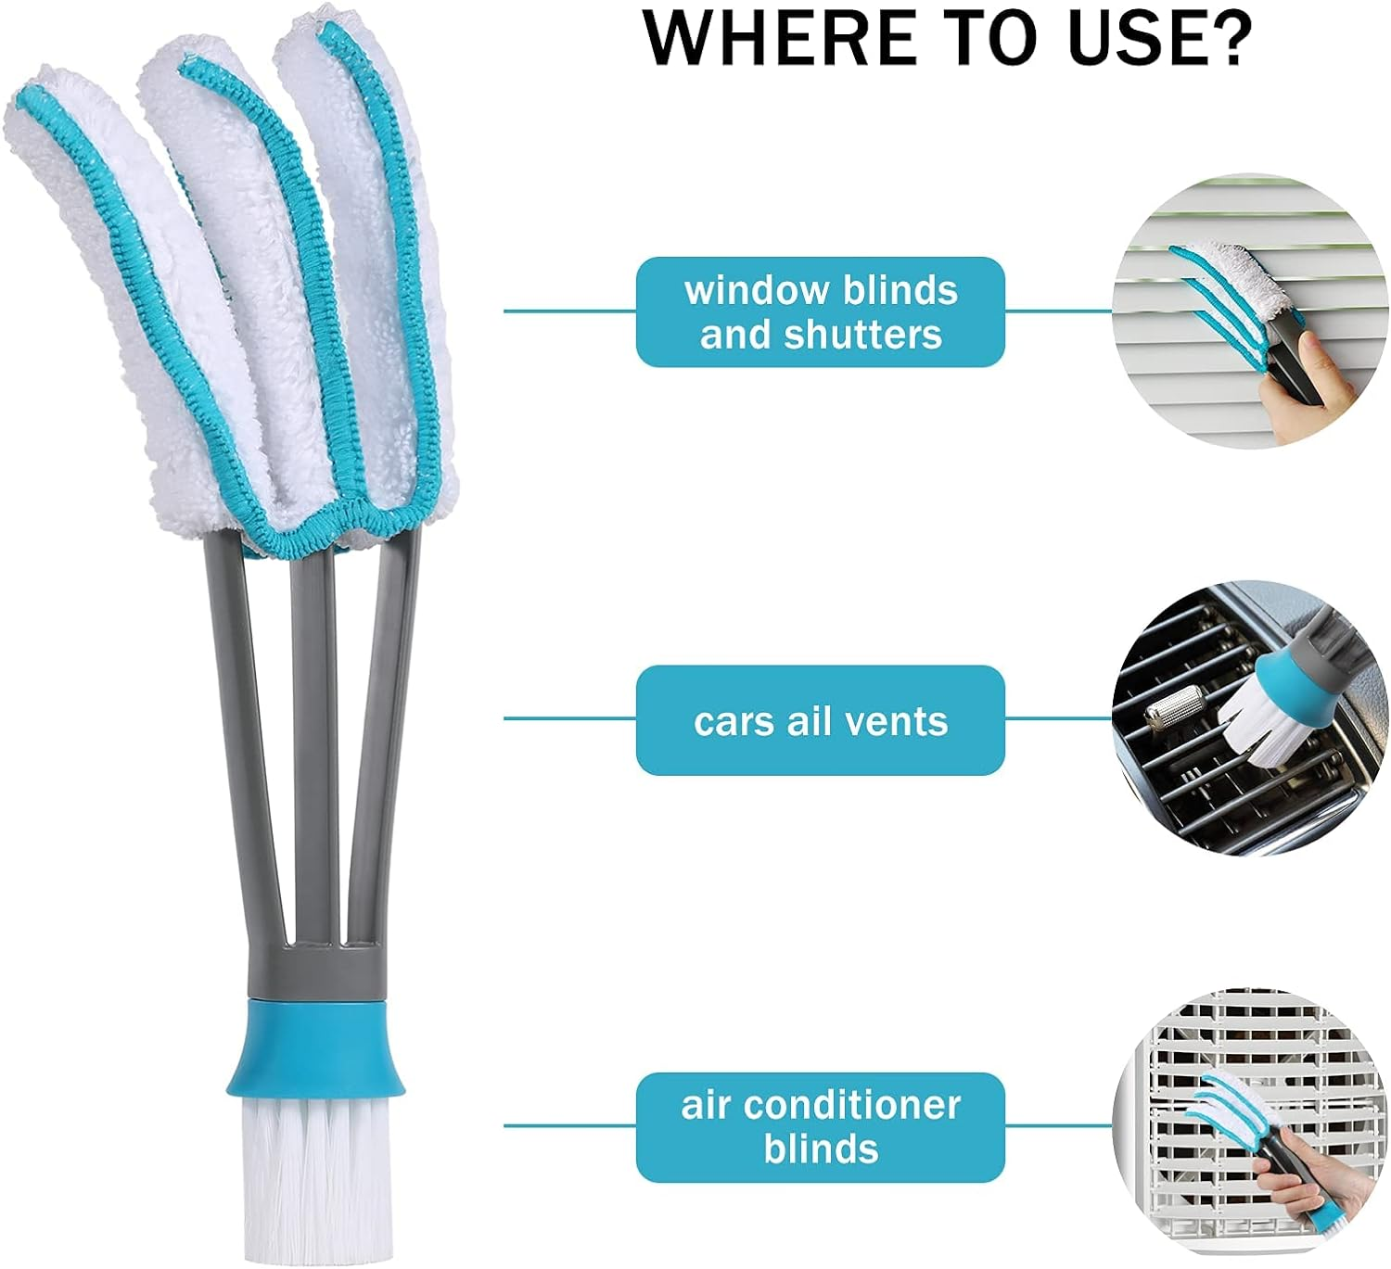
TW-ACP21V5
TW-ACP21V6
This duster is a quick and easy cleaning tool.
Removable sleeves are made from highly absorbent microfiber material. Removable and can be washed repeatedly.
The multi-purpose cleaner can be used not only on blinds, but also on blinds, shades and air conditioning vent hoods. You can use them to clean your car's horizontal or vertical grills or vents, grill/oven grids, etc.
The high-quality 6ind duster is made of high-quality sturdy polyethylene, making it sturdy and durable. Great for cleaning blinds.
The 3-arm blind duster moves and cleans blinds and narrow gaps in one go. The dust brush comes with a small brush at the bottom
Ideal for multi-purpose curtain cleaning. Great for air conditioners, ceiling fans, car exhaust vents, dust collectors

Slide 17
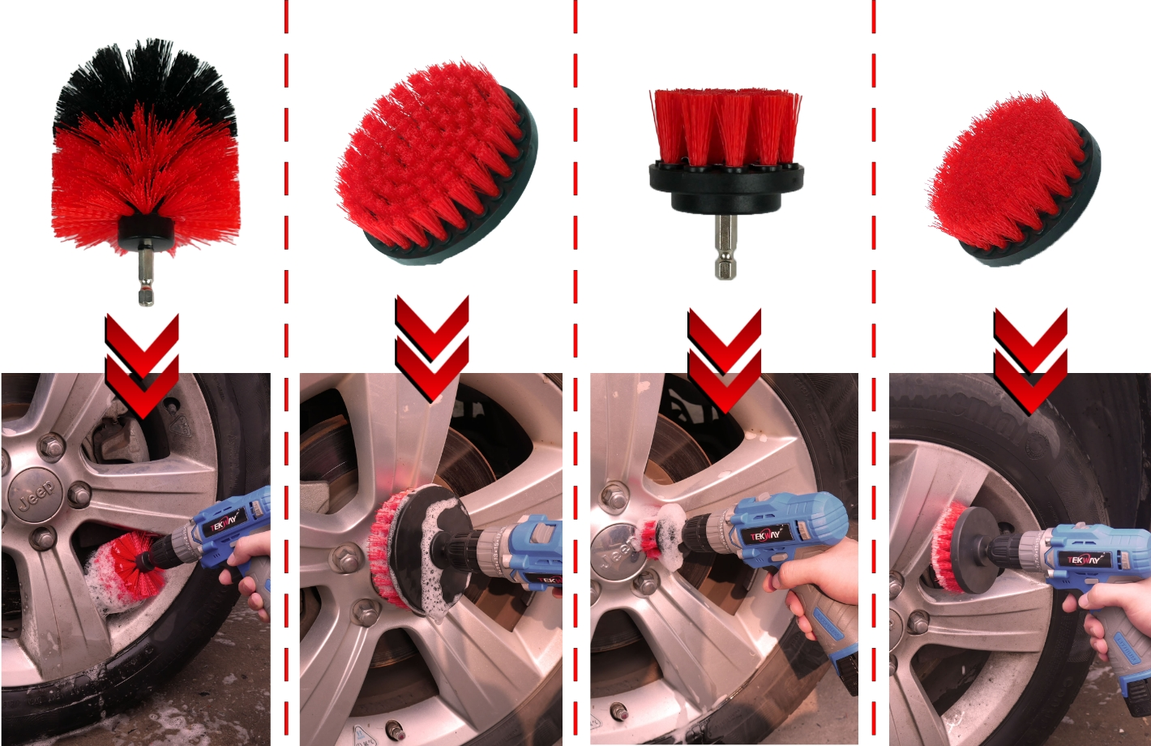
wheel brush
Handle Material：Polypropylene
Material：Nylon
Our Red Brush Set has stiff Bristles which makes it ideal for Outdoor Cleaning.
It can be used as a Grout Brush, Concrete Cleaner and Outdoor Cleaner
Our Product comes with four Brushes. Two Scrub Brushes of 4”& 3.5” respectively which are ideal to clean broad and open surfaces. One Drill bit brush of 2”which is perfect to reach narrow and hard to reach spaces.and a mini detail brush head for fine cleaning of tiny spots,All our brushes have a ¼” quick change shaft which allows the brushes to fit in all cordless drills easily (Drill Not Included)
The Medium and Soft Nylon Bristles products will not leave scratches on the surface, ensuring efficient and safe cleaning. It can be applied on any surface without any worry!

Slide 18
THANKS
感谢观看

