Slide 1

France VR World Space Design
skyfunvr
Guangzhou Skyfun Animation Technology Co., Ltd

Slide 2
In November 2018, we designed the entire plan for the French brand “VR World”, from market research, machine purchase and placement, production of floor plans, 3D drawings, and integration to the actual site.
Guangzhou Skyfun Animation Technology Co., Ltd

Slide 3
France VR World Space Design
The place where have
Visitors flowrate
Have a good propaganda
Have a good management system or way
Guangzhou Skyfun Animation Technology Co., Ltd

Slide 4
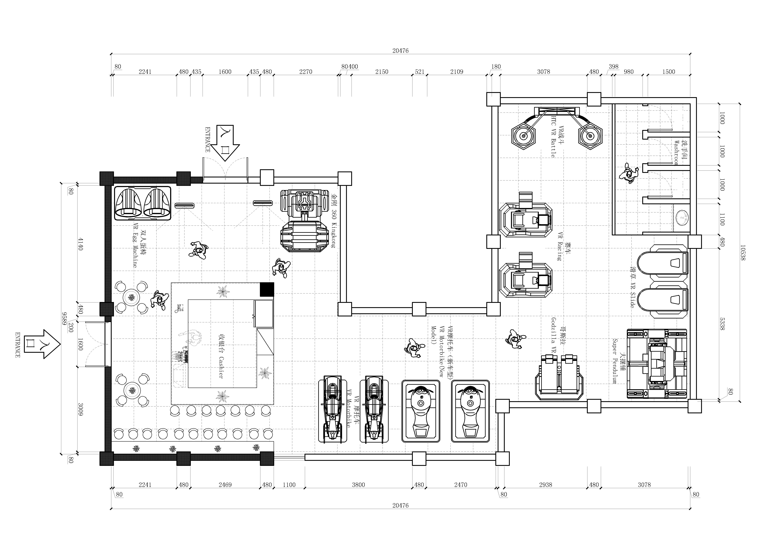
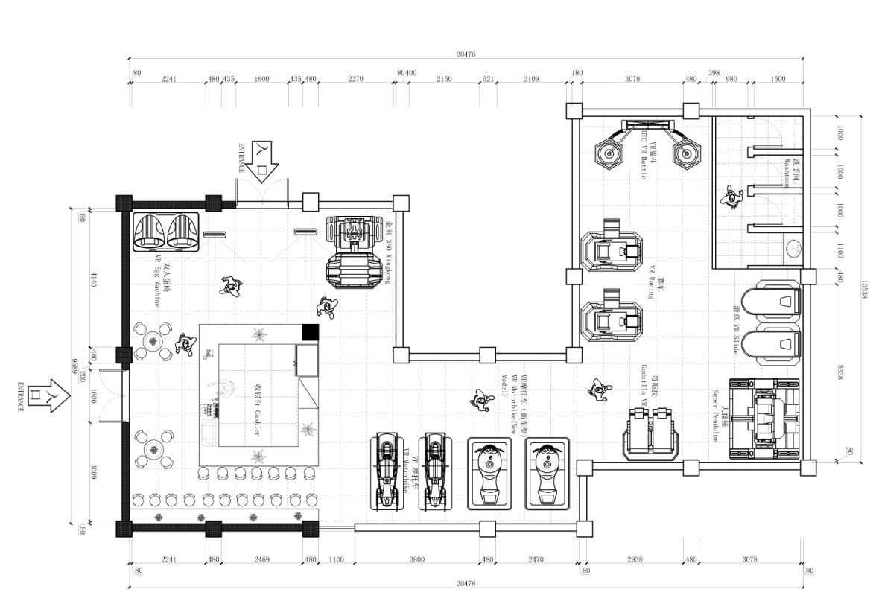
CAD Design picture
100%
Guangzhou Skyfun Animation Technology Co., Ltd

Slide 5
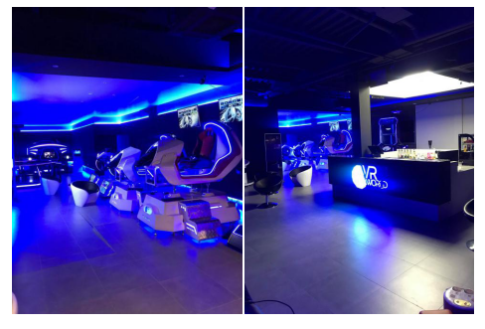
Actual site effect
C
B
A
Guangzhou Skyfun Animation Technology Co., Ltd

Slide 6
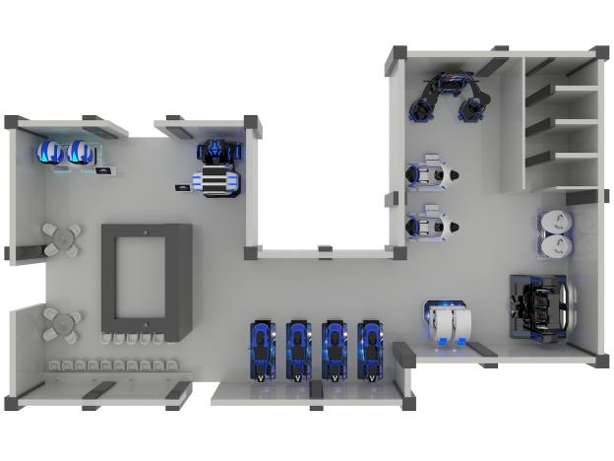
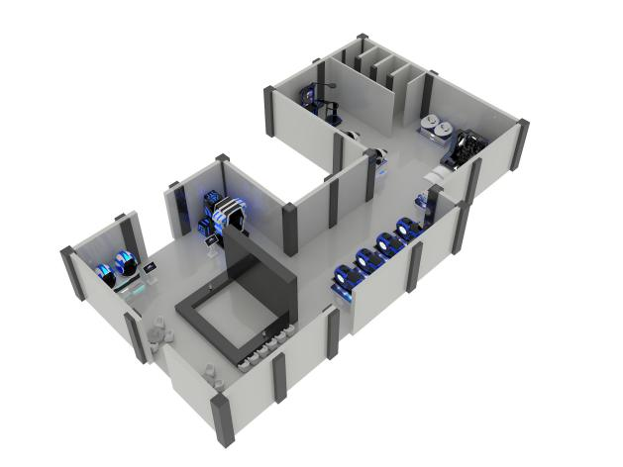
3D design drawings by engineering designers
Guangzhou Skyfun Animation Technology Co., Ltd

Slide 7
Thanks for your time~
--From Skyfun
Guangzhou Skyfun Animation Technology Co., Ltd

