Slide 1

C01890117-B+C01890120-B/NC818-3-2
Moldflow Analysis Report

Slide 2
Catalogue
Page | Project | Page | Project
1 | Home page | 13 | Clam force
2 | Catalogue | 14 | Air Traps
3 | Part thickness Data | 15 | Weld Lines
4 | Material Data | 16 | Volumetric shrinkage at ejection
5 | Part thickness | 17 | Sink estimate
6 | Initial Nozzle/Gate Locations and sizes | 18 | Deflection all effects
7 | Molding Technological Parameter | 19 | Deflection X component
8 | Fill time | 20 | Deflection Y component
9 | Fill time – Animation | 21 | Deflection Z component
10 | Temp. at flow front | 22 | Conclusions and suggestions
11 | Pressure at V/P switchover V/P | 23 | Trailer page
12 | Fill pressure curve

Slide 3
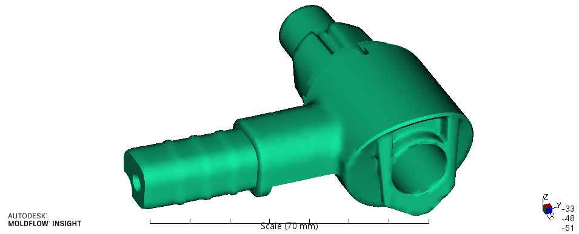
Part thickness Data
Project name(GM) | Project Werkzeugauslegung A236 | Part name(GM)
Part number(SGM) | C01890117-B+C01890120-B | Material | PA6+GF30
Date of Moldflow Review | 2022.12.14 | Moldflow REV | 2019
Mould / Product Company | New Century Tooling | Moldflow Analyst | Mr Ma

Slide 4
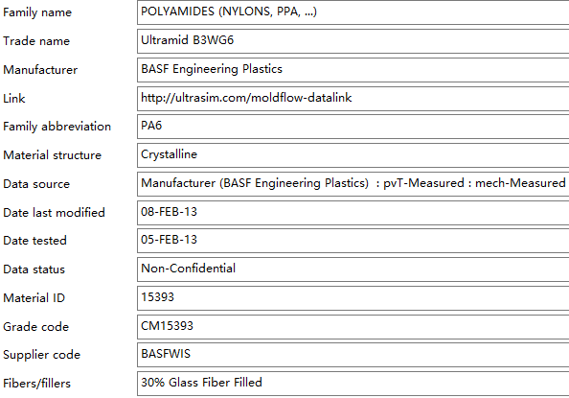
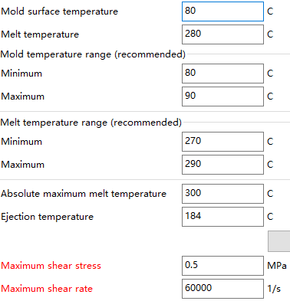
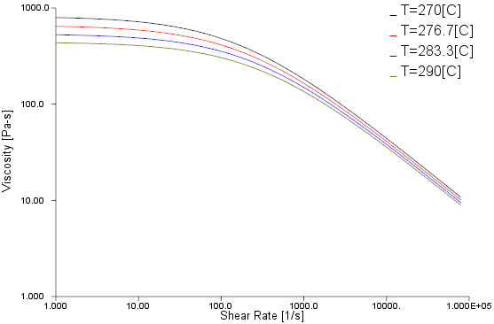
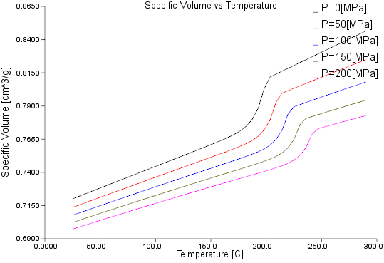
Material Data
General
Recommended Processing
Viscosity
P V T

Slide 5
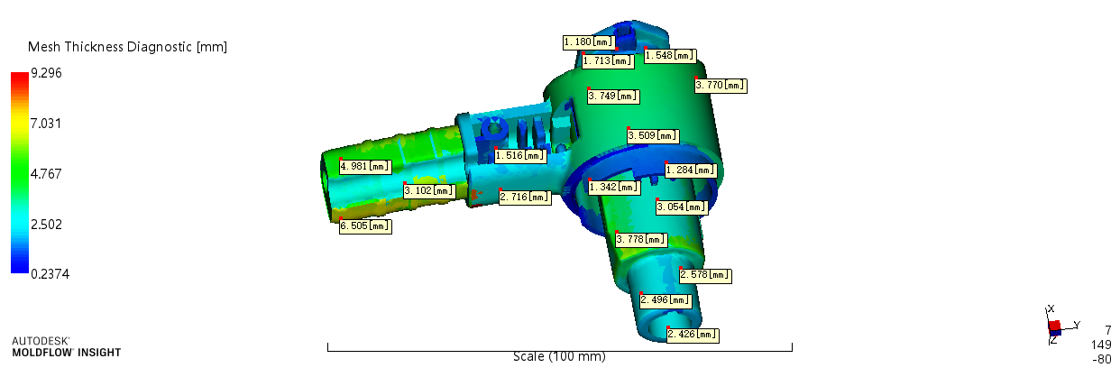
Part thickness
Part thickness Data | Measuring result | Remark
Part thickness (mm) | 2.4~6.54
Part Volume (cm³) | 30.1*2
Part Size (mm) | 71.5*85.6*35.0

Slide 6
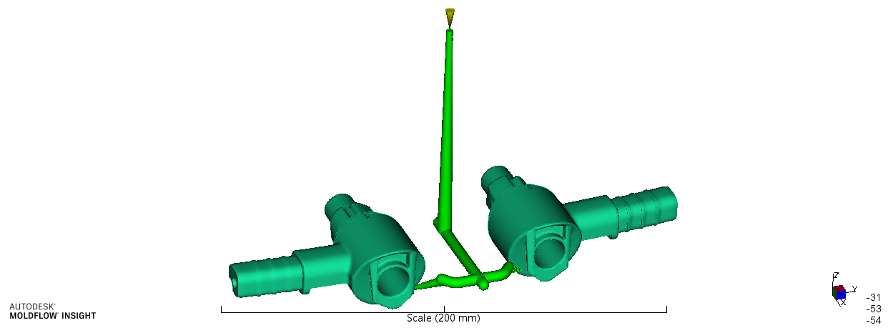
Initial Nozzle/Gate Locations and sizes
Gate D1.5
Gate Locations and sizes reference 3D

Slide 7
Molding Technological Parameter
Filling | 1.0 s
Mold Temperature (℃) | 80
Melt Temperature (℃) | 280
Use mold temperature controller | Yes
Velocity/Pressure Transfer (% volume) | 98%
Packing Pressure /MPa | 89+45
Packing Profile | 2+5 s

Slide 8
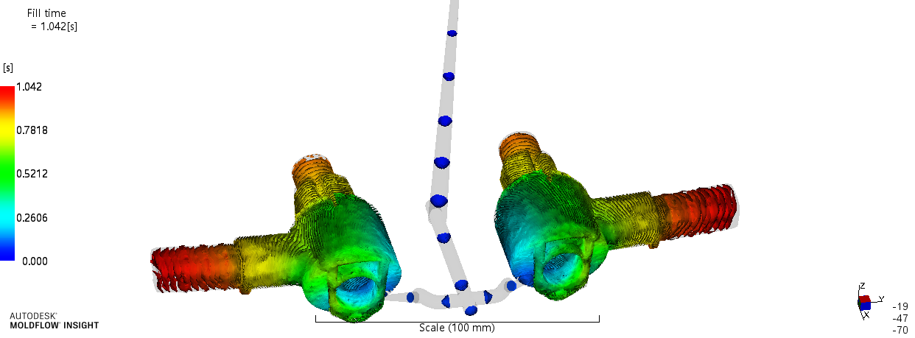
Fill time
Results Explanation: | Fill time Contour can be seen the flow whether balance and whether sluggish.

Slide 9
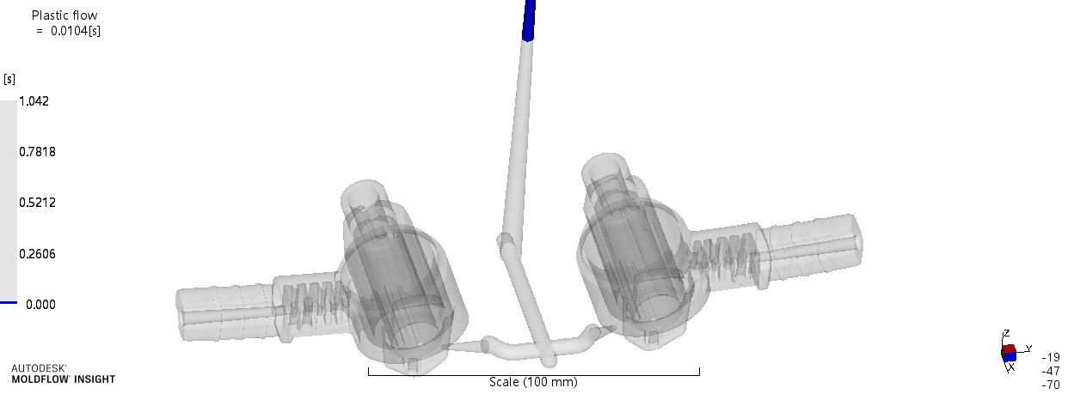
Fill time – Animation
Results Explanation: | Shift +F5 play animation，the melt flow situation& weld line & air trap can find.

Slide 10
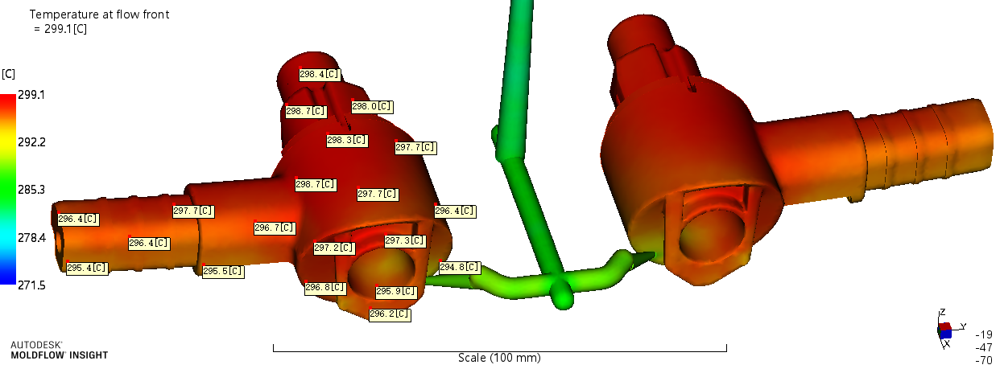
Temp. at flow front
Results Explanation: | Flow front temp. is 272~299 ℃ ，the temperature difference on part main body close to 4 ℃，partial thin ribs resulting in low flow front temp.product has no short shot.

Slide 11
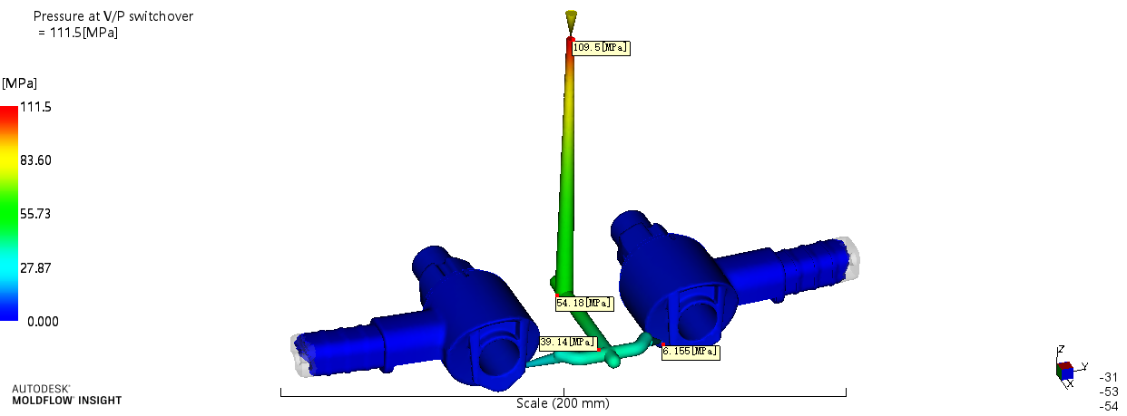
Pressure at V/P switchover
Results Explanation: | The V/P switchover when the part volume is filled at 98%,cavity pressure around 7 Mpa.

Slide 12
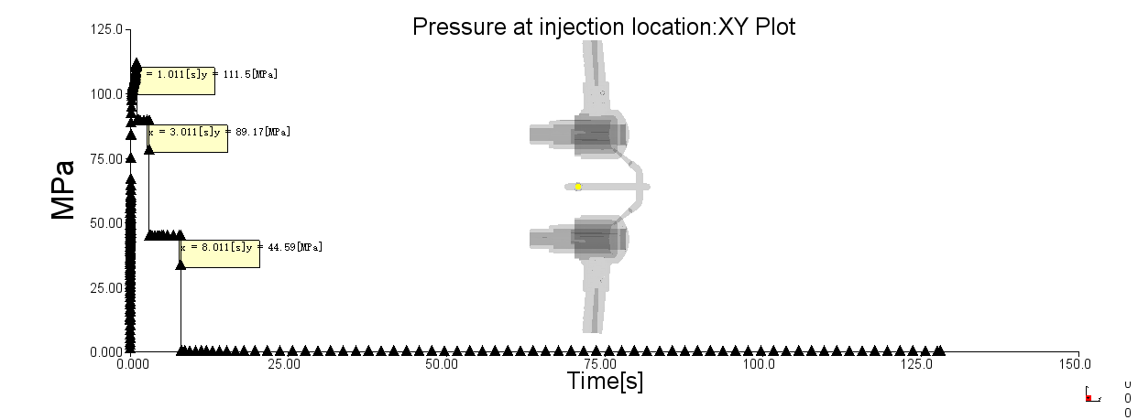
Fill pressure curve
Results Explanation: | The Max.fill pressure around 111.5 Mpa,packing pressure is 89+45 Mpa.

Slide 13
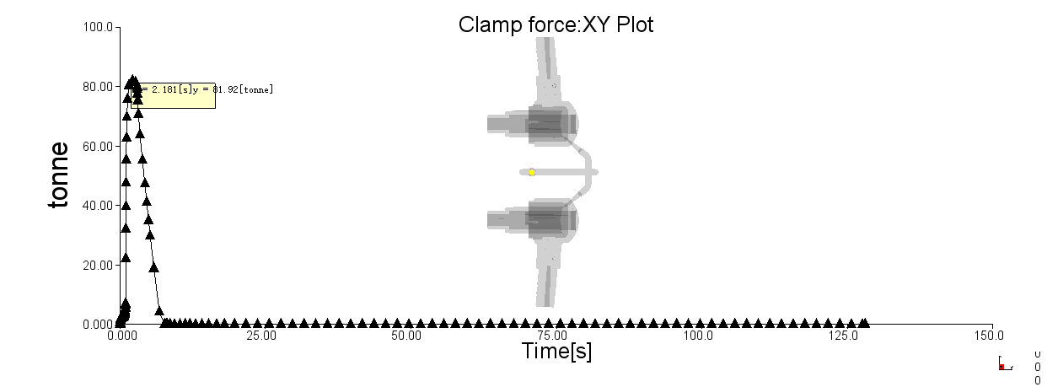
Clam force
Max. clamp force | 82 ton | Clamp force limit | *** ton
Results Explanation: | It would be better to increase 20% safety index regarding the actual situation.

Slide 14
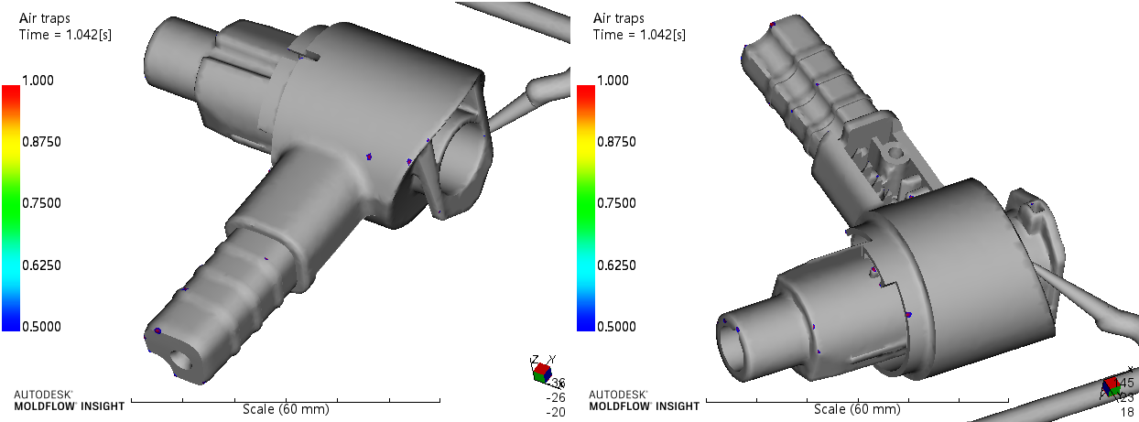
Air Trap
Results Explanation: | No air trap on appearance ,they are distributed in parting line 、corner 、ribs and fill end places ,Which can be solved by adding plenty of venting slot on mold parting surface.

Slide 15
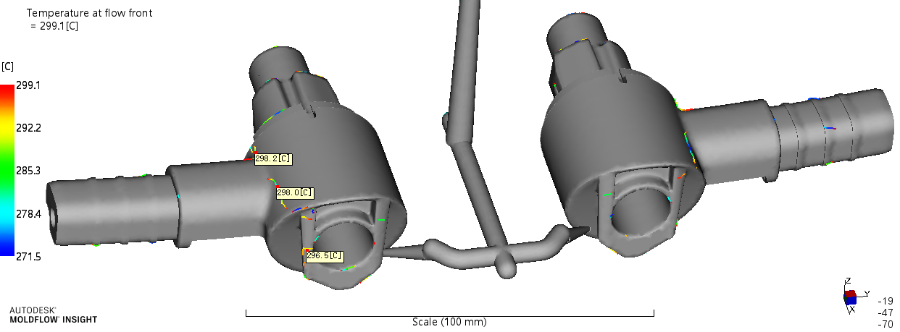
Weld Lines
Results Explanation: | The weld line temp. on the product appearance is higher than material melt temperature, so the hardness and quality of weld line are better.

Slide 16
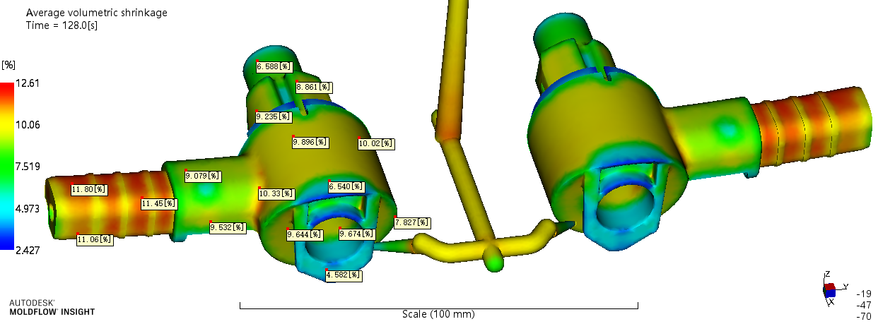
Volumetric shrinkage at ejection
Results Explanation: | Part visual surface volume shrinkage is not even(within cycle time) during ejection, shrinkage is around 6.6~11.8 %,need pay attention to packing pressure.

Slide 17
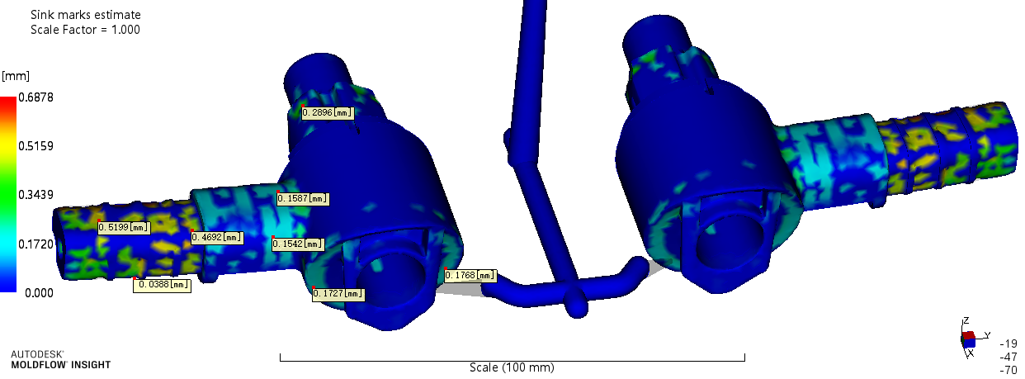
Sink estimate
Results Explanation: | If there are rib or similar function feature on part back side then there will be shrink risk on releated appearance surfaces. The shrinkage range will be big texture part <0.1mm,small texture part<0.05mm,paiting&plating part <0.03mm,high polish part <0.01mm.

Slide 18
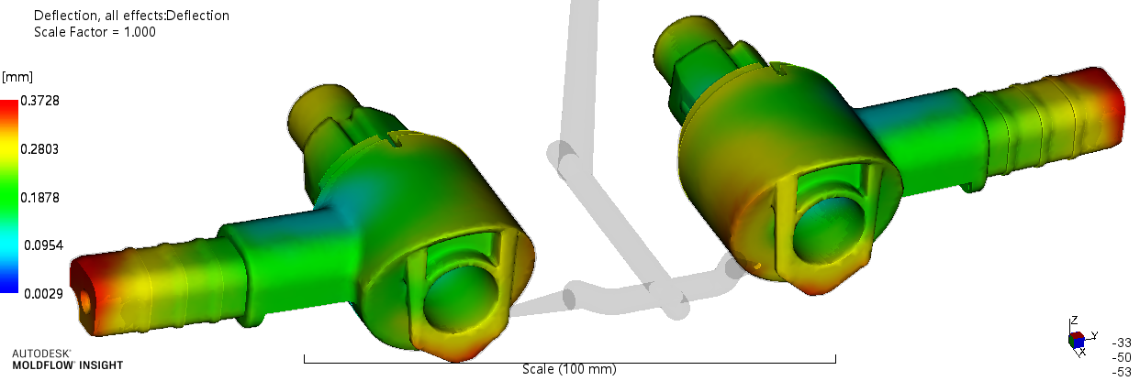
Deflection all effects
Measurement datum | （0，0，0） | Deflection scale | 1:1
 |  | Total deflection | 0.37
Results Explanation: | As shown in the figure, the transparent part is the product before deflection, the colorful part is the product after deflection.

Slide 19
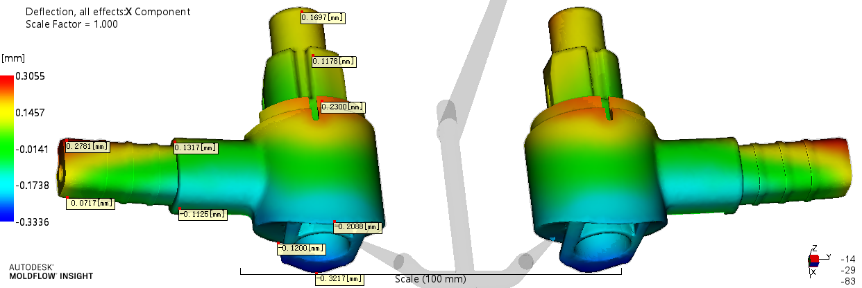
Deflection X component
Measurement datum | （0，0，0） | Deflection scale | 1:1
 |  | Deflection | -0.33~0.31
Results Explanation: | As shown in the figure, the transparent part is the product before deflection, the colorful part is the product after deflection.

Slide 20
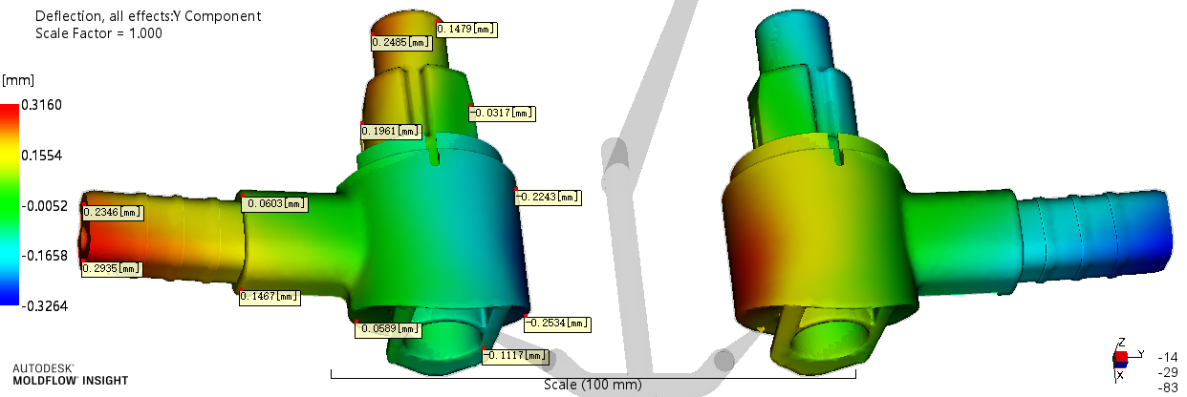
Deflection Y component
Measurement datum | （0，0，0） | Deflection scale | 1:1
 |  | Deflection | -0.33~0.32
Results Explanation: | As shown in the figure, the transparent part is the product before deflection, the colorful part is the product after deflection.

Slide 21
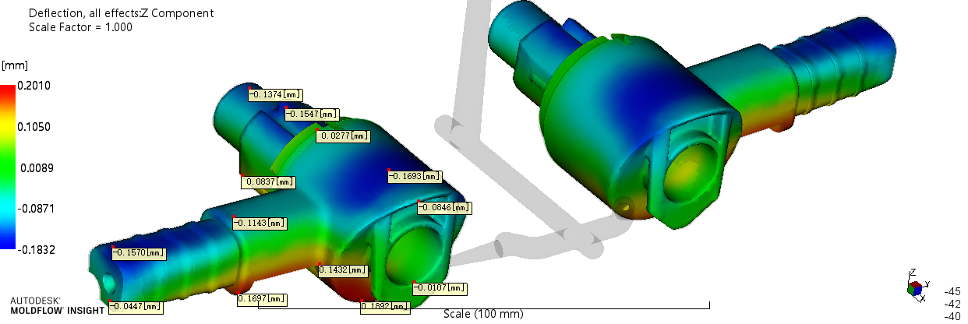
Deflection Z component
Measurement datum | （0，0，0） | Deflection scale | 1:1
 |  | Deflection | -0.18~0.20
Results Explanation: | As shown in the figure, the transparent part is the product before deflection, the colorful part is the product after deflection.

Slide 22
Conclusions and suggestions
Project | Result | Conclusion
filling time (s) | 1.0 | 1.Max pressure is 111.5 Mpa，the pressure is high. 2.The filling process is ok ,no stagnant and short shot. 3.The temperature of most area is even so this result is within the acceptable scope. 4.Pls. confirm if you can accept the weld lines . 5. Products in each direction warpage is not Large ,Please your company confirm if you can accept . 6.Personal points, only for your reference .
Max filling pressure (Mpa) | 111.5
Max clamp force (ton) | 82
Flow front temperature (℃) | 295~299
Volumetric shrinkage (%) | 6.6~11.8
Deflection of Z direction (mm) | -0.18~0.20

Slide 23
Please contact us freely for any questions,
Thank you!

