Slide 1
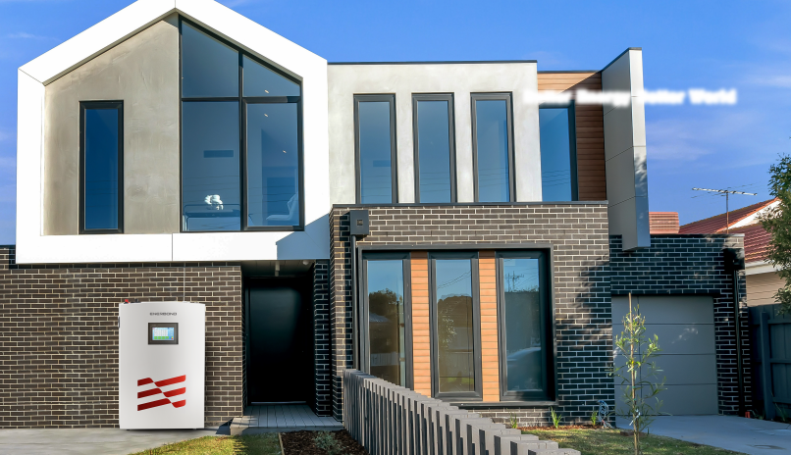
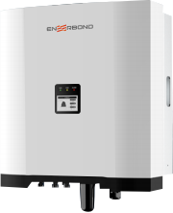
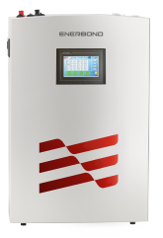
Inverters 6kW-8kW-10kW
Efficiency | Parameter Max Efficiency | GT-EST06KH >98 2% | GT-EST08KH >98 2% |  | GT-EST10KH >98 2%
PV Input | Max. PV input power(W) Max. PV input voltage(V) MPPT Operation Voltage Range (V) Number of MPPT/PV Strings Max. PV input current(A) Short-circuit current of PV input(A) | 7800 1000 180-950 2/1 15/15 18/18 | 10400 1000 180-950 2/1 15/15 18/18 |  | 13000 1000 180-950 2/1 15/15 18/18
Battery | Max Input/Output Voltage(V) Operating Voltage Range(V) Max Charge/Discharge Current(A) Max Input/Output Power(W) Battery Type | 550 180-550 25/30 6000/6000 | 550 180-550 25/30 8000/8000 Li-ion/Lead-acid |  | 550 180-550 25/30 10000/10000
AC Input and Output | Rated Power(W) Max. Apparent AC Power(VA) Nominal AC Voltage(Vac) AC Power Frequency ( Hz) Max. AC Output Current(A) Power Factor Range OutputTHDi(@Nominal Output) | 6000 6000 380,3L/N/PE 50/60 10 |  | 10000 10000 380,3L/N/PE 50/60 15 to 0.8 lagging) <3%
 |  | ~1 (Adjustable <3%
Genaral Data | Operating Temperature Range Topology Cooling Method Ingress Protection Rating Relative Humidity DC Connection Type AC Connection Type Display Communication With Portal Communication With BMS Communication With Meter | -25C …+60C(>45C derating) Transformerless Natural convection IP65 0-100%, no condensation MC/Amphenol/Phoenix Plug-in Connector LCD RS485 (WiFi/GPRS Optinal) CAN RS485
Certification | Safety EMC On-Grid standard | IEC62109-1/-2 EN61000-6-1/-2/-3,IEC61000 AS4777.2:2020 ，NRS097-2-1:2017 ，PN-EN50549-1:2019, VDE-AR-N 4105:2018,EN50549-1:2019+AC:2019-4
Better Energy Better World
8000
8000
380,3L/N/PE
50/60
12
from 0.8 leading
<3%
100% TESTING
Battery energy storage system
Capwall 400V14.4kWh/345V10kWh
Part Number Energy storage Nominal Voltage Maximum Charge Voltage Discharge Cut-off Voltage ESR/AC @1KHz 50% SOC Max. Continuous Charge Current Max. Continuous Discharge Current Round Trip Efficiency Charge Temperature Discharge Temperature Self-discharge Rate Recommended Depth of Discharge Maximum Depth of Discharge Cooling Method Mounting Options Shell Material Communication Monitoring Data Compliance Information Certificate Options | GTEM-400V14.4K-W 14.4kWh 400V/DC 453V/DC 292V/DC <150mΩ 50A 50A 96% 0C~+55C -20C~+60C 2% per month ≤90% 100% Natural Wall/floor Metal & ABS plastic CANbus | GTEF-345V10K-W 10.3kWh 345.6V/DC 390V/DC 300V/DC <100mΩ 15A 30A 97.7% 0C~+45C -30C~+60C 2% per month ≤90% 100% Natural Wall/floor Metal & ABS plastic CAN,RS485
 | System voltage,current,temperature,SOC,SOH,cycle,cell’s voltage IEC62619:2017,IEC62040, EN 62133:2013, EN 55032:2015+AC:2016, EN 55035:2017,EN 61000-3-2:2014, EN 61000-3-3:2013, RoHS, UN38.3, MSDS
Clean Power Supply
^{System} -All-in-One
Solar Panel + Inverter + BESS
Mob/WhatsApp: +86 158 0076 5605 Tel: (021) 5031 0528
E-mail: info@enerbond.com
WhatsApp

Slide 2
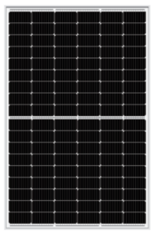
Model: AEN-02( High voltage)
AEN-02 Speciﬁcations
Safety
PV
It can meet the customer's requirement of high voltage energy storage,more stable and safety.
DC
Simple
Cloud Platform
TV
Plug and play,30 mins quick installation
meter or CT
AC
AC
Grid
Electrical parameters at Standard Test Conditions(STC*)
Intercon
-nection
AC
Load
Solar Panel 390-415W
Module type Power output Power output tolerances Module efficiency Voltage at Pmax Current at Pmax Open-circuit voltage Short-circuit voltage | Pmax △Pmax η_{m} Vmpp Impp Vac Isc | W W % V A V A | 390 | YLxxxDF54e/2(xxx=Pmax) 395 400 405 |  |  |  | 410 | 415
 |  |  | 19.97 30.27 12.89 36.80 13.68 | 20.23 30.42 12.99 36.90 13.77 | 20.48 30.56 13.09 37.00 13.86 | 0/+5 20.74 30.71 13.19 37.10 13.95 | 21.00 30.86 13.29 37.20 14.04 |  | 21.25 31.00 13.39 37.30 14.13
Support power internet applications
Capwall
*STC:1000W.m⁻² irradiance,25C cell temperature,AM 1.5 spectrum according to EN 608904-3
Routes Diagram
Electrical parameters at Nominal Operating Cell Temperature(NOCT*)
Power output Voltage at Pmax Current at Pmax Open-circuit voltage Short-circuit voltage | η_{m} Vmpp Impp Voc Isc | % V A V A | 296.85 28.87 10.28 34.98 11.02 | 300.63 29.01 10.36 35.08 11.09 | 304.34 29.01 10.44 35.17 11.17 | 308.17 29.14 10.52 35.27 11.24 | 312.03 29.43 10.60 35.36 11.31 | 315.80 29.56 10.68 35.46 11.38
PV1 PV2 Battery | MPPT1 DC EMI AC Breaker L L N N Battery Load Breaker DC EMI Load
DC
BUS
*NOCT:open-circuit module operation temperature at 800W.m⁻² irradiance,20C ambient temperature,1m*s⁻ ¹ wind speed.
MPPT2
Bifacial electrical parameters at Standard Test Conditions(STC*)
L
Power output Voltage at Pmax Current at Pmax Open-circuit voltage Short-circuit voltage | Pmax Vmpp Impp Voc Isc | % V A V A | 426.86 30.27 14.10 36.80 14.97 | 432.33 30.42 14.21 36.90 15.07 | 437.80 30.56 14.33 37.00 15.17 | 443.27 30.71 14.43 37.10 15.27 | 448.75 30.86 14.54 37.20 15.37 | 454.22 31.00 14.65 37.30 15.47
DC
Switch
DC SPD
AC
Filter
AC
Relay
AC Input
N
*Bifaciality coefficient is 70% ±5% ，rear irradiance is 135W.m⁻²
Inverter
Circuit
THERMAL CHARACTERISTICS
Breaker
Nominal operating cell temperature Temperature coefficient of Pmax Temperature coefficient of Voc Temperature coefficient of Isc | NOCT γ β α | C %/C %/C %/C | 39±2 -0.35 -0.28 0.05
DC/DC
AC SPD
*Bifaciality coefficient is 70% ±5% ，rear irradiance is 135W.m⁻²

